Slide 1
Mastering the Job Search
Rich Blazevich

Slide 2
Recap: Class #1
Preferred Type of Job → Job Descriptions
Job Hunting Strategy → Tracker

Slide 3
Preferred Job Type
Marketing Job Description
Identify marketing program ideas
Lead agencies in the development of marketing content and campaigns
Lead cross-functional teams in development and launch of new products
Develop selling materials and presentations for sales organization

Slide 4
Tracker

Slide 5
Recap: Classes #1 & #2
Preferred Type of Job → Job Descriptions
Job Hunting Strategy → Tracker
3. Job Descriptions → Resumes
4. Opening Questions → P.E.N. Answer

Slide 6
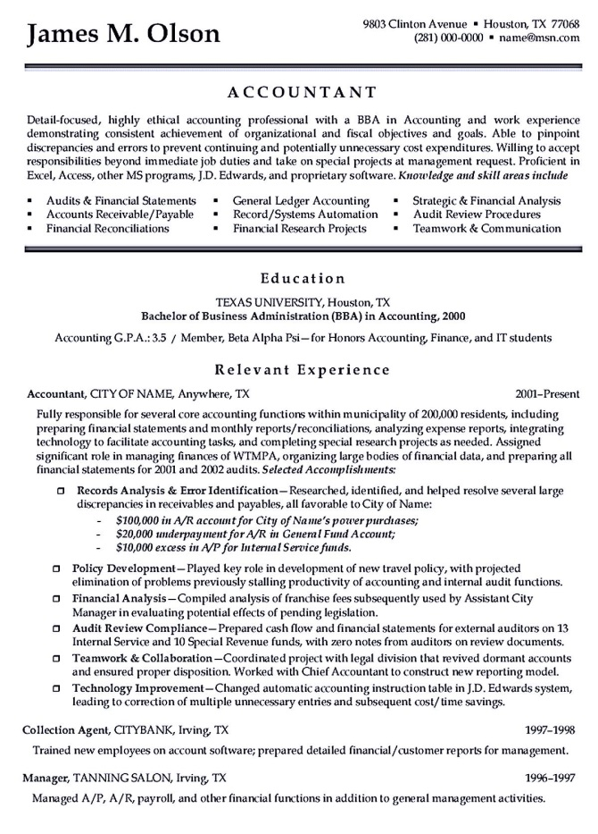
Resume
Lots of redundant and non-specific adjectives & duties
Laundry list of skills
Can’t decide between paragraphs and bullet points
Too much detail on 1 job and too little detail on others

Slide 7
Resume

Slide 8
Resume
Contact Information
Education
Experience
Additional Information

Slide 9
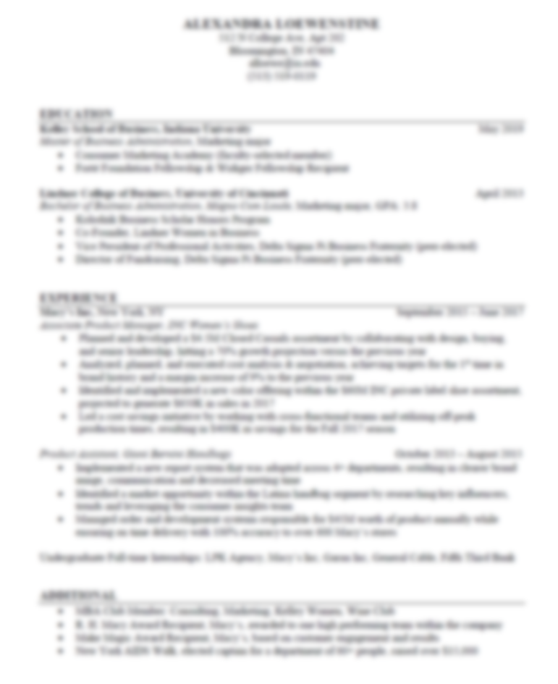
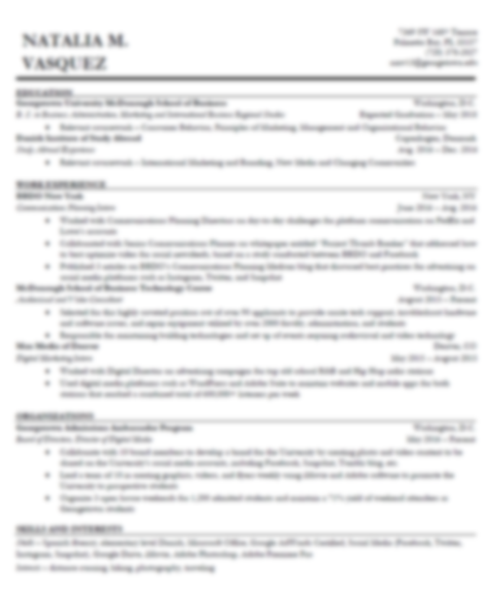
Resume

Slide 10
Resume: Section 1
Name
Address
E-mail & Phone Number
Website or LinkedIn Site (optional)

Slide 11
Resume: Section 2
COLLEGE NAME City, State
Degree Graduation Date
Activities, Honors, Awards

Slide 12
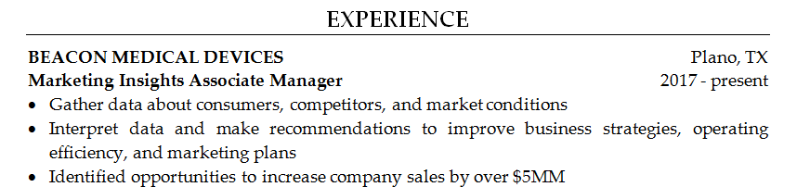
Resume: Section 3
ORGANIZATION NAME City, State
Job Title Years Worked
Activities & Results (these should match the job description)

Slide 13
Resume: Section 4
Activities
Interests

Slide 14
Resume
Contact Information
Education
Experience
Additional Information

Slide 15
Types of Interview Questions
Opening Questions
Fit Questions
Case Questions
Closing Questions

Slide 16
Types of Interview Questions
1. Opeing Questions
2. Fit Questions
3. Case Questions
4. Closing Questions

Slide 17
1. Experience Questions
Tell me about yourself.
Walk me through your resume.
Why should I hire you?
What’s been your favorite job?

Slide 18
“Facts tell, stories sell.”
Interview Secret

Slide 19
P-E-N Framework
Passion
Experience
Next

Slide 20
Passion: “I’ve always had a passion for…
… finding creative solutions to challenging problems.”
… building high-performance teams.”
… figuring out what motivates people.”
… analyzing complex issues.”
… working with diverse groups of people.”
Hint: Choose something from the job description.

Slide 21
Experience: “When I was …
… in school, I …”
… working as a _______, I …”
… on a _______ team, I …”
Hint: Use experiences related to the job description.

Slide 22
Next: “Now, I want to find a job …
… that allows me to …”
… that will give me an opportunity to …”
… where I can …”
Hint: Tell them you want to work for them next.

Slide 23
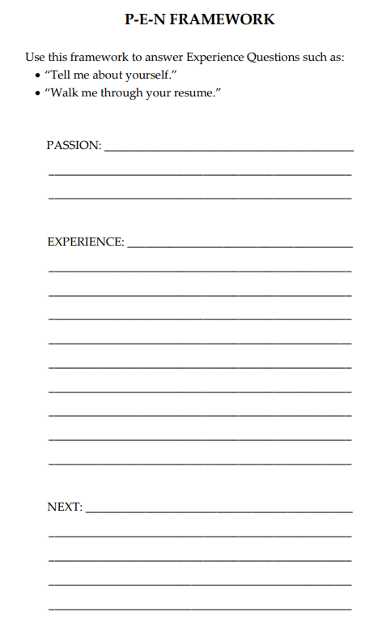
P-E-N Framework
http://amazingjobskills.com/wp-content/uploads/2017/07/Framework-templates-for-Amazing-Interview-Answers.pdf

Slide 24
Recap: Classes #1 & #2
Preferred Type of Job → Job Descriptions
Job Hunting Strategy → Tracker
3. Job Descriptions → Resumes
4. Opening Questions → P.E.N. Answer

Slide 25
This Class
Job Descriptions + Resumes
→ Cover Letters
2. Interview Answers
→ S.T.A.R. & 4P’s Answers

Slide 26
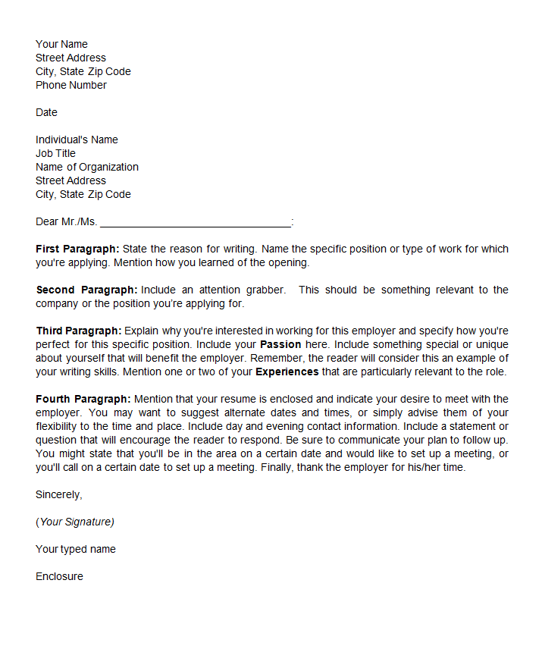
Cover Letter
Heading
Purpose of Letter
Attention Grabber
Passion & Experience
Request for Interview

Slide 27
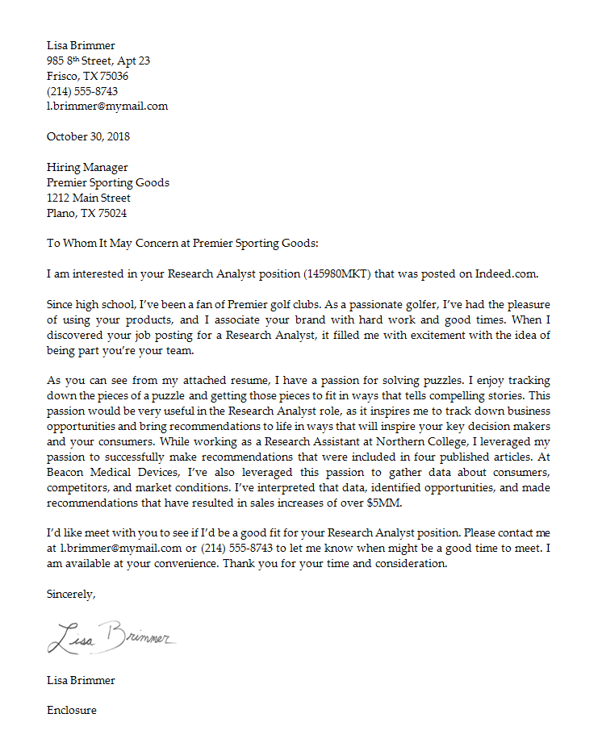
Cover Letter
Heading
Purpose of Letter
Attention Grabber
Passion & Experience
Request for Interview

Slide 28
Cover Letter: Heading
Heading

Slide 29
Cover Letter: Paragraph 1
Purpose of Letter

Slide 30
Cover Letter: Paragraph 2
Attention Grabber

Slide 31
Cover Letter: Paragraph 3
Attention Grabber

Slide 32
Cover Letter: Paragraph 4
Request for Interview

Slide 33
Cover Letter
Heading
Purpose of Letter
Attention Grabber
Passion & Experience
Request for Interview

Slide 34
This Class
Job Descriptions + Resumes
→ Cover Letters
2. Interview Answers
→ S.T.A.R. & 4P’s Answers

Slide 35
This Class
Job Descriptions + Resumes
→ Cover Letters
2. Interview Questions
→ P.E.N., S.T.A.R., and 4P’s Answers

Slide 36
Get a list of interview questions
Opening Questions
Fit Questions
Case Questions
Closing Questions

Slide 37
Types of Interview Questions
1. Experience Questions
2. Fit Questions
3. Case Questions
4. Closing Questions

Slide 38
2. Fit Questions
Tell me about a time when you demonstrated
leadership, creativity, analytical skills, etc.
What’s your greatest strength?
How would a co-worker describe you?

Slide 39
Example
“What’s your
greatest strength?”

Slide 40
Option 1 or Option 2
“What’s your greatest strength?”

Slide 41
Situation: “When I was working as a …”
S-T-A-R Framework
Task: “… my assignment was to …”
Actions: “First, I … Then, I … Finally, I …”
Result: “As a result, …”

Slide 42
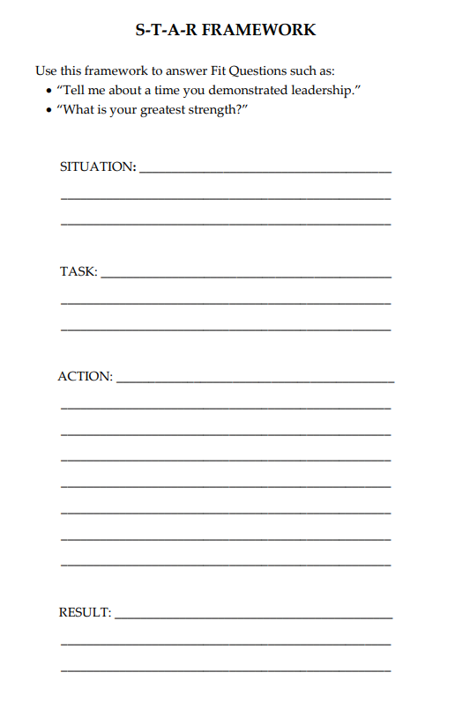
S-T-A-R Framework
http://amazingjobskills.com/wp-content/uploads/2017/07/Framework-templates-for-Amazing-Interview-Answers.pdf

Slide 43
Types of Interview Questions
1. Experience Questions
2. Fit Questions
3. Case Questions
4. Closing Questions

Slide 44
Example
“You’re working on a snack brand,
and your sales are down 20%.
What do you do?”

Slide 45
Option 1 or Option 2
“… develop a new product. What first?”

Slide 46
4-P’s Framework
Product
Placement
Pricing
Promotion

Slide 47
Product
Has something changed with my product?
Have my competitors changed their products?

Slide 48
Placement
Is anything changing where I sell my product? Traffic? Shelf-space?
What is happening with distribution for my competitors?

Slide 49
Pricing
Have I changed my pricing?
Have my competitors changed their pricing?
Have consumers become more or less price sensitive?

Slide 50
Promotions
Have I changed my marketing tactics, message, or spend?
Is my marketing message effective?
What promotions are my competitors doing?

Slide 51
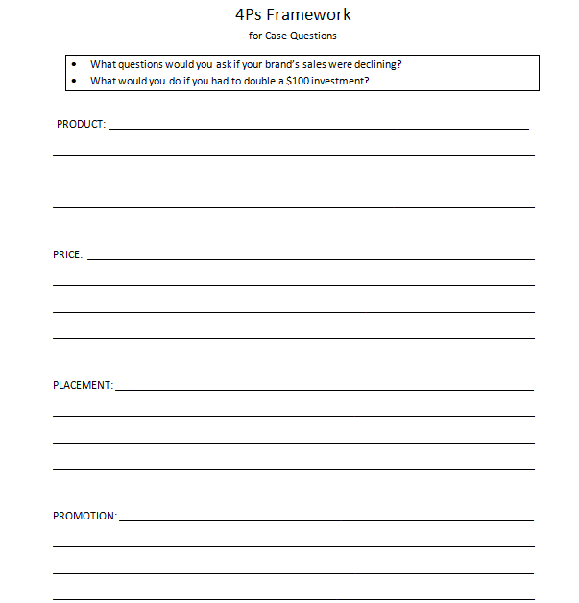
4Ps Framework
http://amazingjobskills.com/wp-content/uploads/2017/07/Framework-templates-for-Amazing-Interview-Answers.pdf

Slide 52
Types of Interview Questions
1. Experience Questions
2. Fit Questions
3. Case Questions
4. Closing Questions

Slide 53
Is there anything else I should know about you?
Tell your best S-T-A-R story
that you haven’t told yet.

Slide 54
What questions do you have for me?
What do you like most
about working at PepsiCo?
vs.
What do you like least
about working at PepsiCo?

Slide 55
What questions do you have for me?
What characteristics are most important
for someone succeeding in this role?
vs.
What could cause someone to be
unsuccessful in this role?

Slide 56
What questions do you have for me?
Why did you choose to work
for this company?
vs.
What are the biggest challenges
you face in your role?

Slide 57
Get a list of interview questions
Opening Questions
Fit Questions
Case Questions
Closing Questions

Slide 58
Question: What do recruiters look for?

Slide 59
Answer: What recruiters look for:
Positive
Passionate
Consumer Focus
Highly collaborative
Thrive in ambiguity
Leadership with results
Can you market yourself?

