Slide 1
Job Search Workshop
Rich Blazevich

Slide 2
Who Am I?

Slide 3
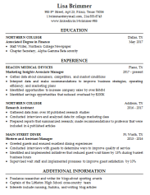
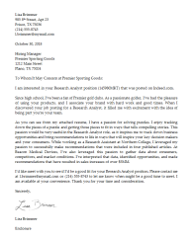
Job Hunting 101
3 Levels of Training
Job Hunting 102
Job Hunting Master’s Class
60 minute workshop
200 page book
4 classes + homework

Slide 4
Agenda
Form an Interview Group
Build Your Job Hunting Strategy
Polish Your Resume
Practice Interview Questions
Nail Your Interviews

Slide 5
Best Career Advice Ever

Slide 6
1. Form an Interview Group

Slide 7
Agenda
Form an Interview Group
Build Your Job Hunting Strategy
Build Your Resume
Practice Interview Questions
Nail Your Interviews

Slide 8
2. Build Your Interview Strategy
Option
Resumes
Cover Letters
Interviews
Objective
Option
Option

Slide 9
Job Hunting Tracker

Slide 10
Agenda
Form an Interview Group
Build Your Job Hunting Strategy
Build Your Resume
Practice Interview Questions
Nail Your Interviews

Slide 11
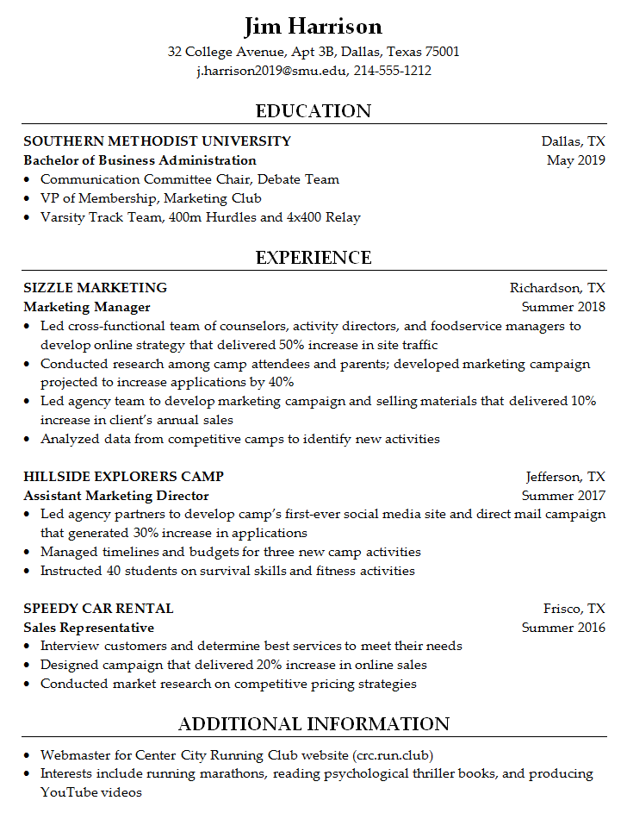
3. Build Your Resume
Contact Information
Education
Experience
Additional Information

Slide 12
Resume: Section 1
Name
Address
E-mail & Phone Number
Website or LinkedIn Site (optional)

Slide 13
Resume: Section 2
COLLEGE NAME City, State
Degree Graduation Date
Activities, Honors, Awards

Slide 14
Resume: Section 3
ORGANIZATION NAME City, State
Job Title Years Worked
Activities & Results (these should match the job description)

Slide 15
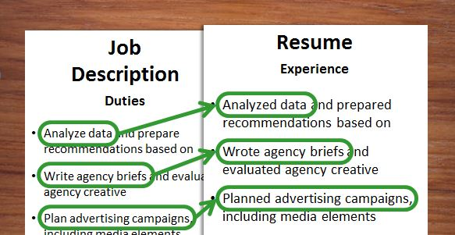
3. Customize Your Resume

Slide 16
3. Customize Your Resume
Job Description | Resume
Analyze data and identify opportunities to deliver sales growth | Analyzed data and identified opportunity to growth sales with new services valued at $50K
Generate brand marketing strategies based on consumer and marketplace insights | Generated brand marketing strategy based on insight that consumers wanted convenient package solutions; projected to deliver incremental sales of $100K
Manage project timelines and budgets for marketing programs | Manage project timelines and budgets; identified opportunities to reduce project timeline by 20% and budgeted costs by $5,000
Lead cross-functional teams to develop launch plans and selling materials for new products | Led cross-functional team to develop selling materials for new line of products projected to deliver sales of $100K/year
Write agency briefs and evaluate creative content for marketing campaigns | Wrote agency briefs and evaluated creative for social media campaign projected to reach 100K consumers

Slide 17
Resume: Section 4
Activities
Interests

Slide 18
Resume
Contact Information
Education
Experience
Additional Information

Slide 19
Agenda
Form an Interview Group
Build Your Job Hunting Strategy
Build Your Resume
Practice Interview Questions
Nail Your Interviews

Slide 20
4. Practice Interview Questions
Opening Questions
Fit Questions
Case Questions
Closing Questions

Slide 21
Types of Interview Questions
1. Opening Questions
2. Fit Questions
3. Case Questions
4. Closing Questions

Slide 22
1. Opening Questions
Tell me about yourself.
Walk me through your resume.
Why should I hire you?
What’s been your favorite job?

Slide 23
“Facts tell, stories sell.”
Interview Secret

Slide 24
P-E-N Framework
Passion
Experience
Next

Slide 25
Passion: “I’ve always had a passion for…
… finding creative solutions to challenging problems.”
… building high-performance teams.”
… figuring out what motivates people.”
… analyzing complex issues.”
… working with diverse groups of people.”
Hint: Choose something from the job description.

Slide 26
Experience: “When I was …
… in school, I …”
… working as a _______, I …”
… on a _______ team, I …”
Hint: Use experiences related to the job description.

Slide 27
Next: “Now, I want to find a job …
… that allows me to …”
… that will give me an opportunity to …”
… where I can …”
Hint: Tell them you want to work for them next.

Slide 28
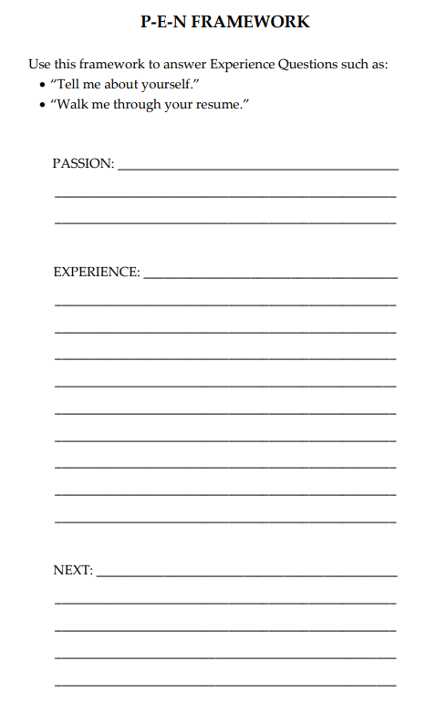
P-E-N Framework
www.amazingjobskills.com
click on “Templates” link

Slide 29
Types of Interview Questions
1. Experience Questions
2. Fit Questions
3. Case Questions
4. Closing Questions

Slide 30
2. Fit Questions
Tell me about a time when you demonstrated
leadership, creativity, analytical skills, etc.
What’s your greatest strength?
How would a co-worker describe you?

Slide 31
Example
“What’s your
greatest strength?”

Slide 32
Option 1 or Option 2
“What’s your greatest strength?”

Slide 33
Situation: “When I was working as a …”
S-T-A-R Framework
Task: “… my assignment was to …”
Actions: “First, I … Then, I … Finally, I …”
Result: “As a result, …”

Slide 34
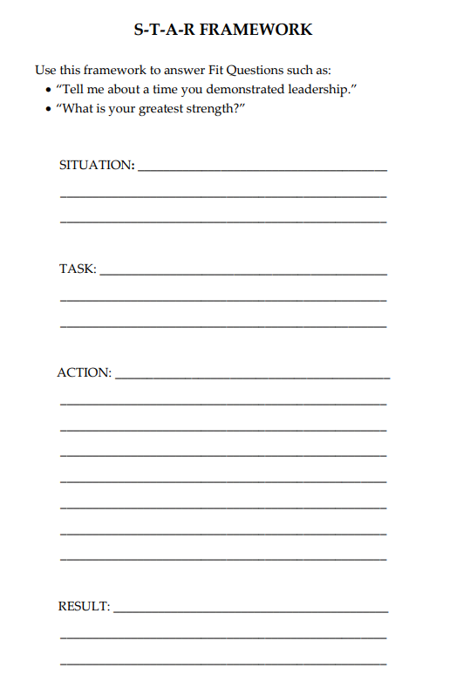
S-T-A-R Framework
www.amazingjobskills.com
click on “Templates” link

Slide 35
Types of Interview Questions
1. Experience Questions
2. Fit Questions
3. Case Questions
4. Closing Questions

Slide 36
Example
“You’re working on a snack brand,
and your sales are down 20%.
What do you do?”

Slide 37
Option 1 or Option 2
“… develop a new product. What first?”

Slide 38
4-P’s Framework
Product
Placement
Pricing
Promotion

Slide 39
Product
Has something changed with my product?
Have my competitors changed their products?

Slide 40
Placement
Is anything changing where I sell my product? Traffic? Shelf-space?
What is happening with distribution for my competitors?

Slide 41
Pricing
Have I changed my pricing?
Have my competitors changed their pricing?
Have consumers become more or less price sensitive?

Slide 42
Promotions
Have I changed my marketing tactics, message, or spend?
Is my marketing message effective?
What promotions are my competitors doing?

Slide 43
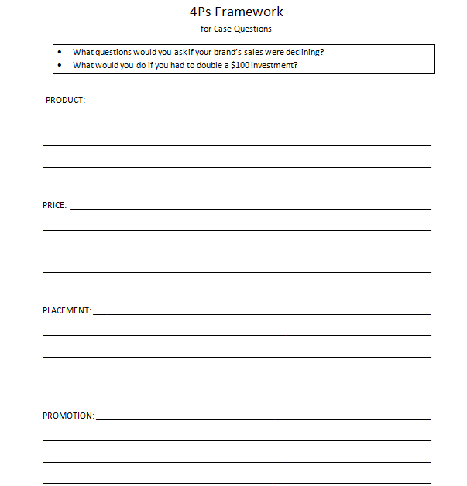
4Ps Framework
www.amazingjobskills.com
click on “Templates” link

Slide 44
Types of Interview Questions
1. Experience Questions
2. Fit Questions
3. Case Questions
4. Closing Questions

Slide 45
Is there anything else I should know about you?
Tell your best S-T-A-R story
that you haven’t told yet.

Slide 46
What questions do you have for me?
What do you like most
about working at PepsiCo?
vs.
What do you like least
about working at PepsiCo?

Slide 47
What questions do you have for me?
What characteristics are most important
for someone succeeding in this role?
vs.
What could cause someone to be
unsuccessful in this role?

Slide 48
What questions do you have for me?
Why did you choose to work
for this company?
vs.
What are the biggest challenges
you face in your role?

Slide 49
Agenda
Form an Interview Group
Build Your Job Hunting Strategy
Build Your Resume
Practice Interview Questions
Nail Your Interviews

Slide 50
5. Nail Your Interviews What do recruiters look for?

Slide 51
Answer: What recruiters look for:
Positive
Passionate
Consumer Focus
Highly collaborative
Thrive in ambiguity
Leadership with results
Can you market yourself?

Slide 52
Agenda
Form an Interview Group
Build Your Job Hunting Strategy
Build Your Resume
Practice Interview Questions
Nail Your Interviews

Slide 53
Job Hunting 101
3 Levels of Training
Job Hunting 102
Job Hunting Master’s Class
60 minute workshop
200 page book
4 classes + homework

