Slide 1
Mastering the Job Search
Rich Blazevich
January 2019

Slide 2
Who Am I?

Slide 4
Best Career Advice Ever

Slide 5
1. Form an Interview Group

Slide 6
Story Time

Slide 7
2. Build Your Job Hunting Strategy
Option
Resumes
Cover Letters
Interviews
Objective
Option
Option

Slide 8
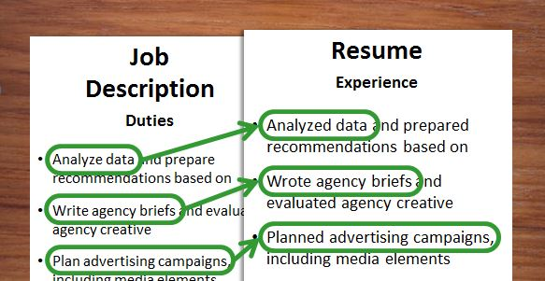
3. Customize Your Resume

Slide 9
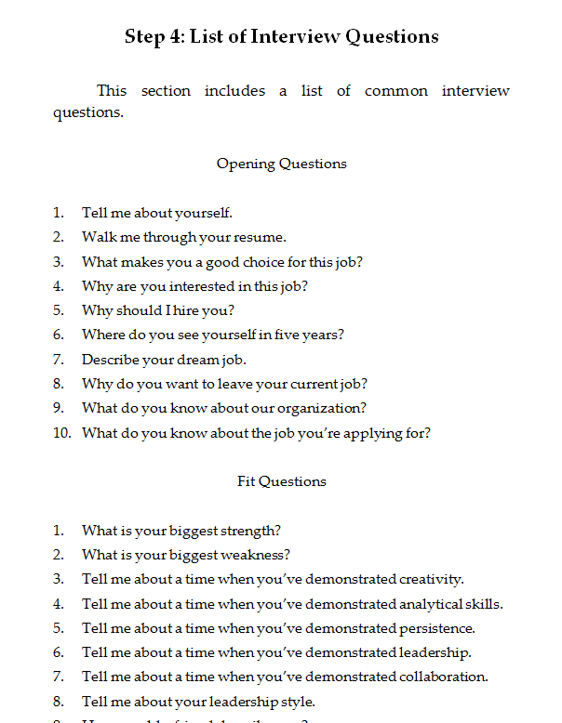
4. Get a List of Interview Questions
see
Interview Prep Playbook
page 159

Slide 10
Option 1 or Option 2
5. Practice Opening Questions
“Tell Me
About
Yourself”

Slide 11
5. Practice Opening Questions
Passion
“Tell Me
About
Yourself”
Experience
Next

Slide 12
6. Practice Behavior Questions
Option 1 or Option 2
“Tell Me
About a
Time When
…”

Slide 13
6. Practice Behavior Questions
Situation: “When I was working as a …”
Task: “… my assignment was to …”
Actions: “First, I … Then, I … Finally, I …”
Result: “As a result, …”

Slide 14
7. Practice Case Questions
Option 1 or Option 2
“What
Would You
Do If …”

Slide 15
7. Case Questions
Your brand’s sales are declining.
What would you do?
You’re leading a team, and
the team members aren’t getting along.
What would you do?

Slide 16
Example
“You’re working for
a snack company, and
you’re brand’s sales are declining.
What would you do?”

Slide 17
Option 1 or Option 2
“What do you do?”

Slide 18
3-C’s Framework
Consumer
Company Competitions

Slide 19
4-P’s Framework
Product
Placement
Pricing
Promotion

Slide 20
Closing Questions
Is there anything else
I should know about you?
What questions do you have for me?

Slide 21
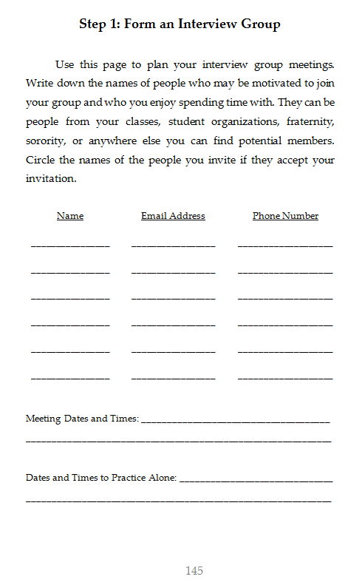
Interview Group
Worksheet
page 145

Slide 22
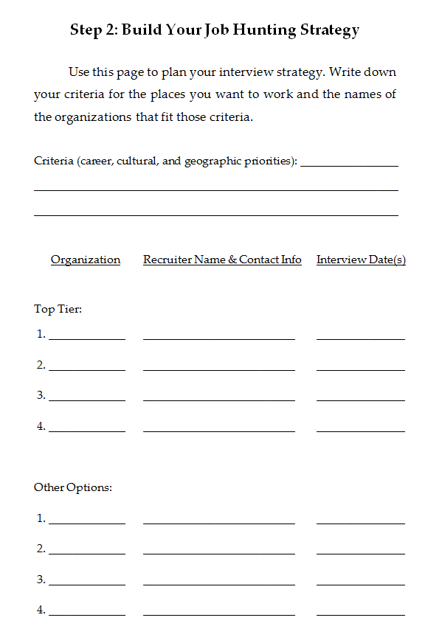
Interview Group
Worksheet
page 145
Job
Hunting
Strategy
page 147

Slide 23
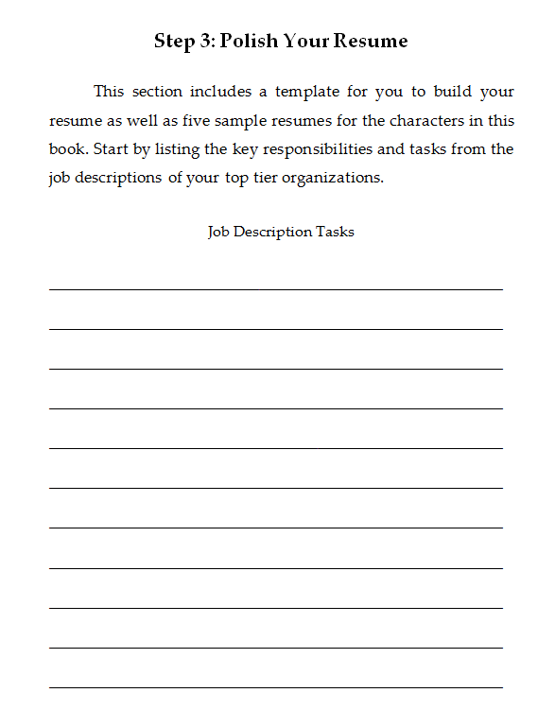
Interview Group
Worksheet
page 145
Job
Hunting
Strategy
page 147
Resume
Templates
page 149

Slide 24
Interview Group
Worksheet
page 145
Job
Hunting
Strategy
page 147
Resume
Templates
page 149
Sample
Interview
Questions
page 159

Slide 25
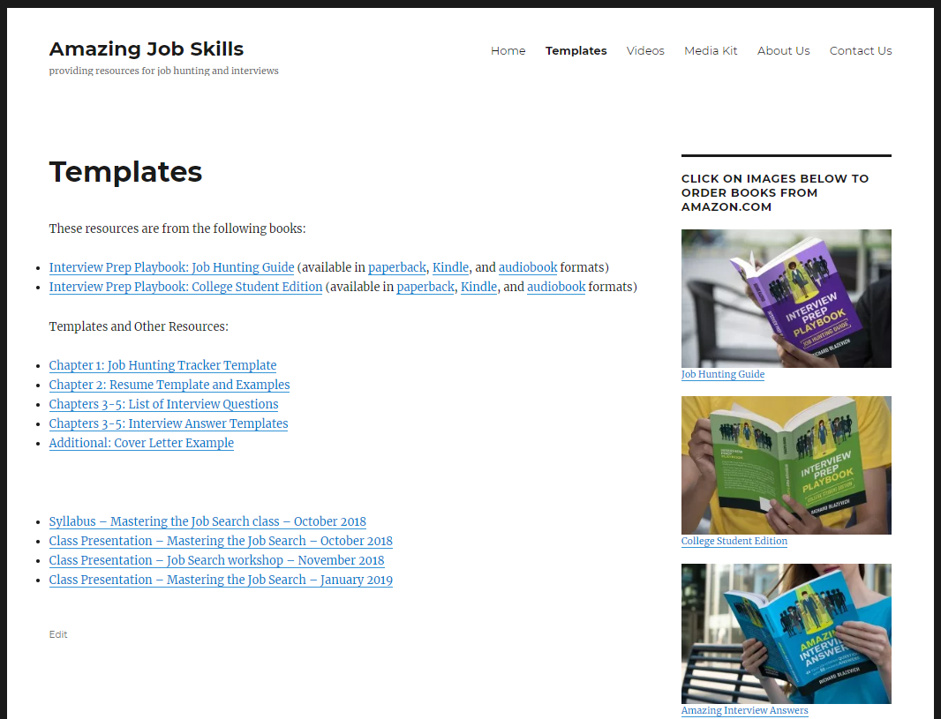
www.AmazingJobSkills.com
Templates
Resources
Today’s File

Slide 26
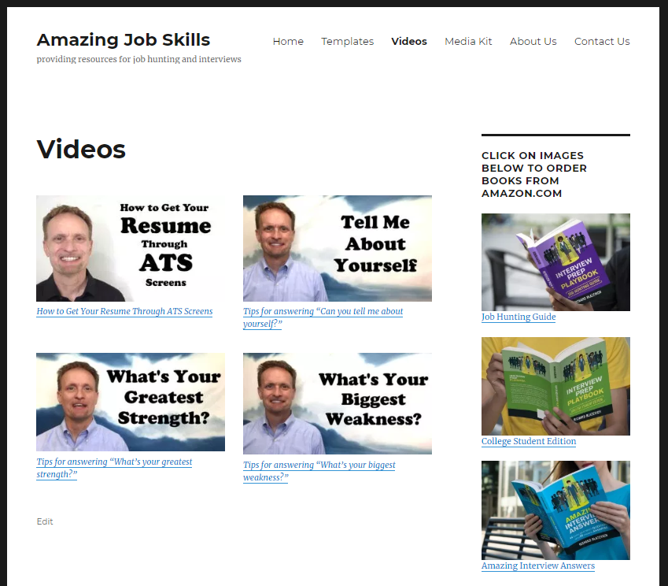
www.AmazingJobSkills.com
Videos
Videos

Slide 27
What recruiters look for:
Positive
Passionate
Consumer Focus
Highly collaborative
Thrive in ambiguity
Leadership with results
Can you market yourself?

Slide 28
3 Levels of Training
Level 1:
Workshop
Level 2:
Book
Level 3:
GO Course
Interview
Strategy Class
Interview
Playbook
Master
Class

