Slide 1
Mastering the Job Search
Rich Blazevich

Slide 2
This Course
Week 1: Your Job Hunting Strategy
Week 2: Your Resume
Week 3: Your LinkedIn Profile & Cover Letters
Week 4: Your Interview Answers

Slide 3
A Little About Me …

Slide 4
A Little More About Me …
Career Coaching Workshops

Slide 5
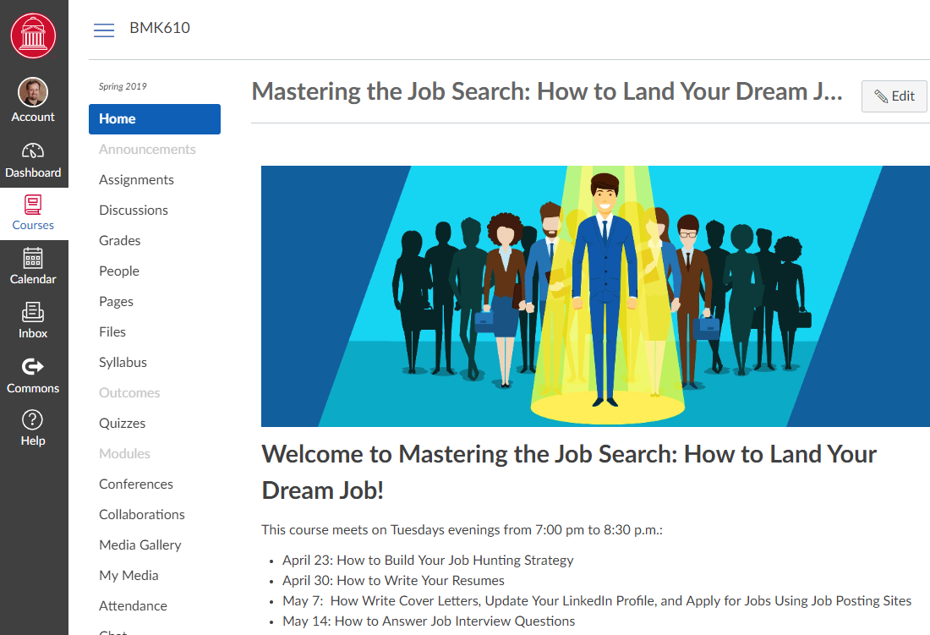
Course Canvas Site
https://smulearnonline.instructure.com/courses/164

Slide 6
Course Materials
Required:
or
Optional:
Online Class:
Amazing
Resumes &
Cover Letters
Online Class:
Amazing
Job Interview
Answers
$99.99 $9.99
$99.99 $9.99

Slide 7
Class #1: Job Hunting Strategy
Which career field?
Which type of job?
Which specific job?

Slide 8
1. Which Career Field?
Marketing
Teaching
Nursing

Slide 9
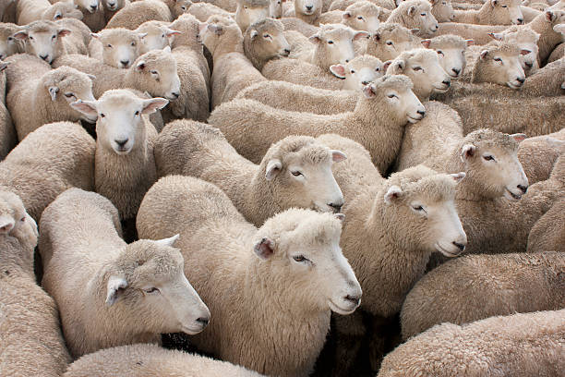
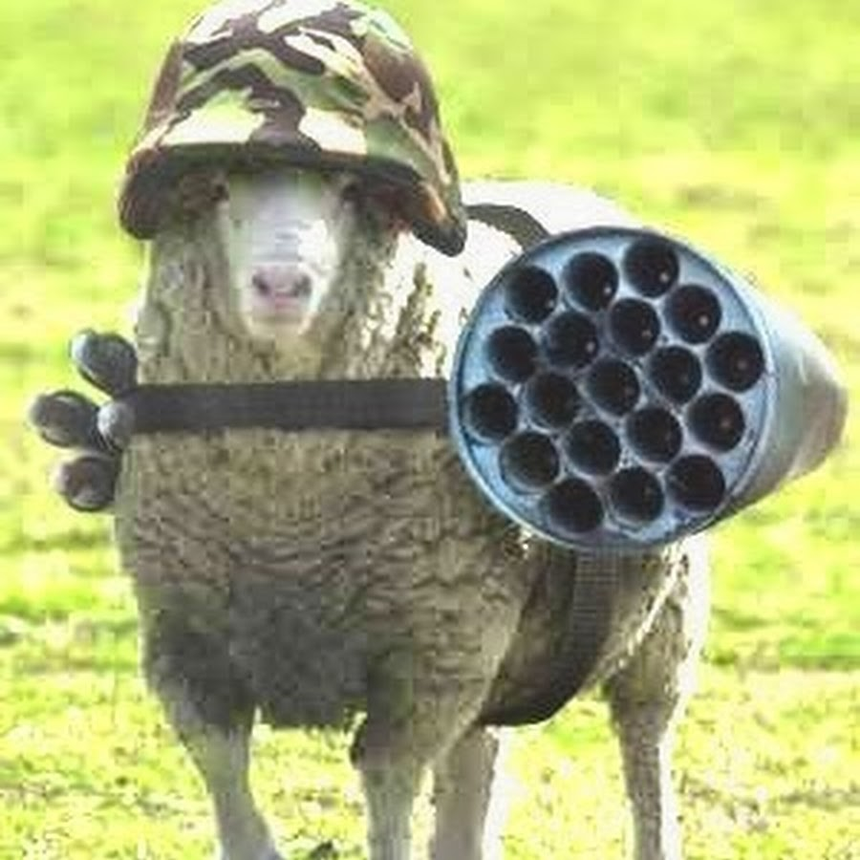
Your Secret Weapon

Slide 10
Secret Weapon: Job Description
teach
plan
duties
write
skills
recommend
present
JOB
DESCRIPTION
coordinate
education
manage
experience
responsibilities
job title
requirements
design
lead
build
program
prepare

Slide 11
1. Which Career Field?
Marketing
Teaching
Nursing
Build advertising campaigns
Manage agency teams
Analyze data
Create lesson plans
Develop & grade assignments
Teach students
Record medical information
Administer medications
Care for patients

Slide 12
1. Which Career Field?
Marketing
Teaching
Nursing
Build advertising campaigns
Manage agency teams
Analyze data
Create lesson plans
Develop & grade assignments
Teach students
Record medical information
Administer medications
Care for patients

Slide 13
2. Which Type of Job?
Teaching
Option 1: K-12 Teacher
Option 2: College Professor
Option 3: Corporate Trainer
Other Options
Create lesson plans
Develop & grade assignments
Teach students

Slide 14
2. Which Type of Job?
Teaching
Option 1: K-12 Teacher
Option 2: College Professor
Option 3: Corporate Trainer
Other Options
Create lesson plans
Develop & grade assignments
Teach students

Slide 15
3. Which Specific Job?

Slide 16
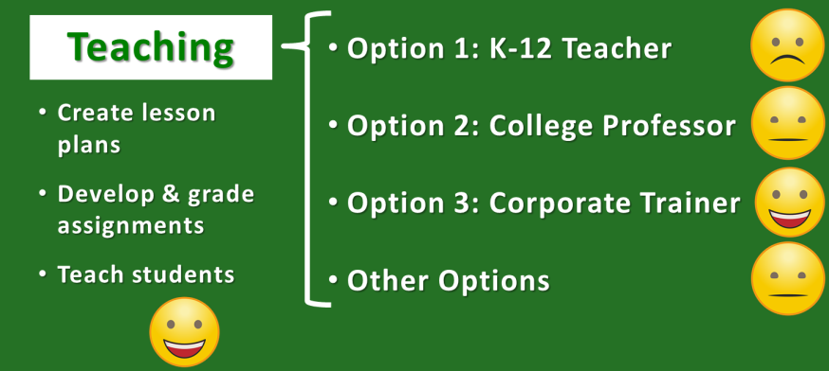
3. Which Specific Job?
Company 1
Company 2
Company 3
Other Companies

Slide 17
3. Which Specific Job?
My Criteria:
Positive Culture
Close to Home
Products I Like
Prestigious Company

Slide 18
3. Which Specific Job?
Your Criteria:
Learning Opportunities
Advancement Opportunities
Collaborative Co-Workers
Short Commute
Low-Stress Environment
No Travel
Work from Home
Flexible Hours
Benefits
Salary

Slide 19
Assignment #1 Your Job Hunting Tracker

Slide 20
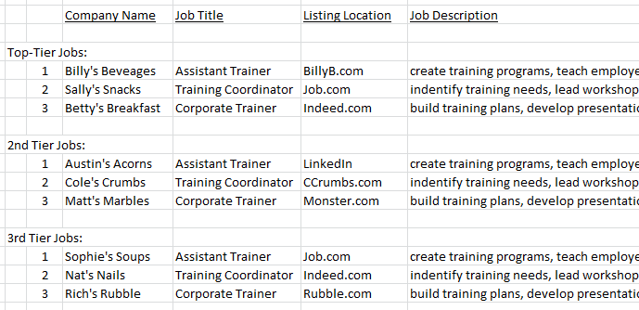
Assignment: Your Job Hunting Tracker

Slide 21
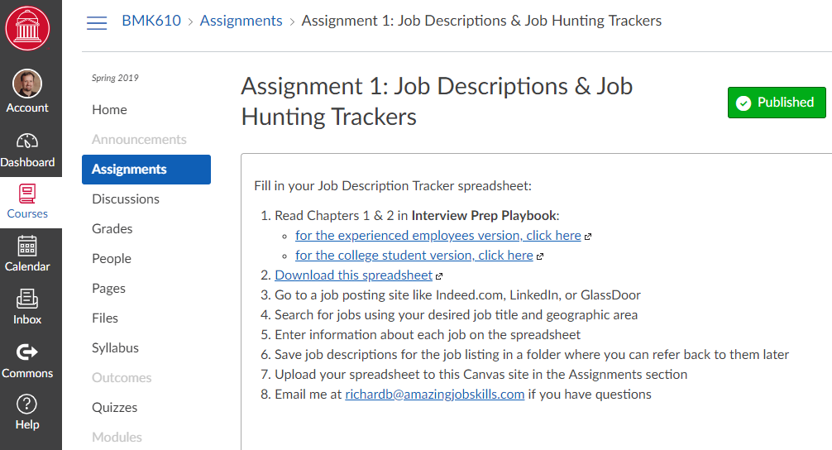
Assignment: Your Job Hunting Tracker

Slide 22
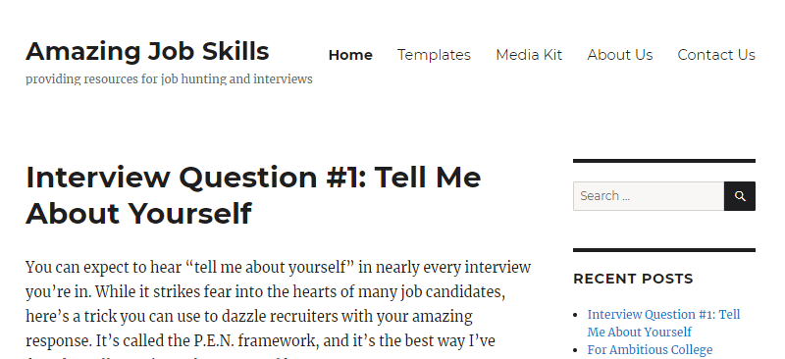
Assignment: Your Job Hunting Tracker
www.AmazingJobSkills.com
Templates

Slide 23
Assignment: Your Job Hunting Tracker
Chapter 1: Job Hunting Tracker Template

Slide 24
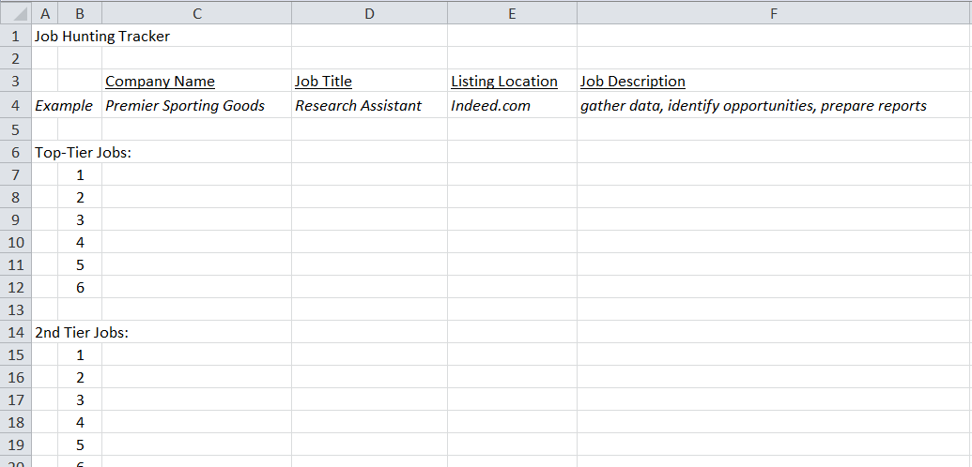
Homework

Slide 25
Homework

Slide 26
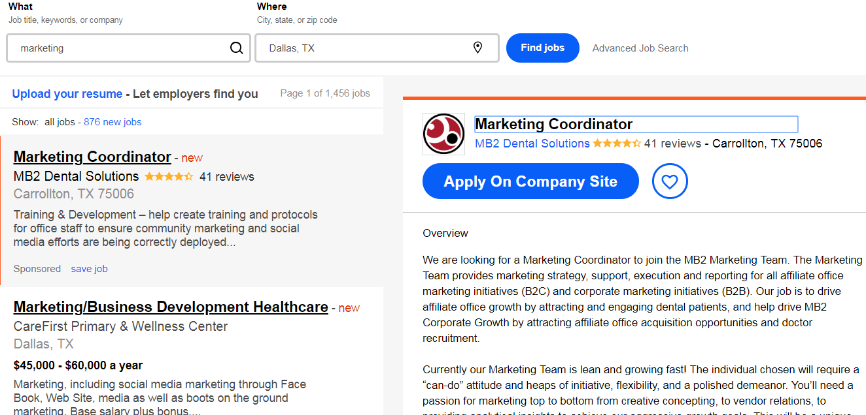
Homework

Slide 27
Assignment: Your Job Hunting Tracker

Slide 28
This Course
Week 1: Your Job Hunting Strategy
Week 2: Your Resume
Week 3: Your LinkedIn Profile & Cover Letters
Week 4: Your Interview Answers

Slide 29
This Course
Week 1: Your Job Hunting Strategy
Week 2: Your Resume
Week 3: Your LinkedIn Profile & Cover Letters
Week 4: Your Interview Answers

Slide 30
Hiring Process
Identify
Opening
Write Job
Description
Candidates
Apply
Screen
Applications
Interview
Finalists
Extend
Offer

Slide 31
Hiring Process
Identify
Opening
Write Job
Description
Candidates
Apply
Screen
Applications
Interview
Finalists
Extend
Offer

Slide 32
Hiring Process
Identify
Opening
Write Job
Description
Candidates
Apply
Screen
Applications
Interview
Finalists
Extend
Offer

Slide 33
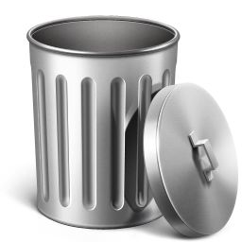
ATS Screening Process
Resume
Resume
Resume
Resume
Resume
Resume
ATS Screening Software
Resume

Slide 34
ATS Screening Process
Application
Application
Application
Application
Application
Application
ATS Screening Software
Application

Slide 35
Key Words

Slide 36
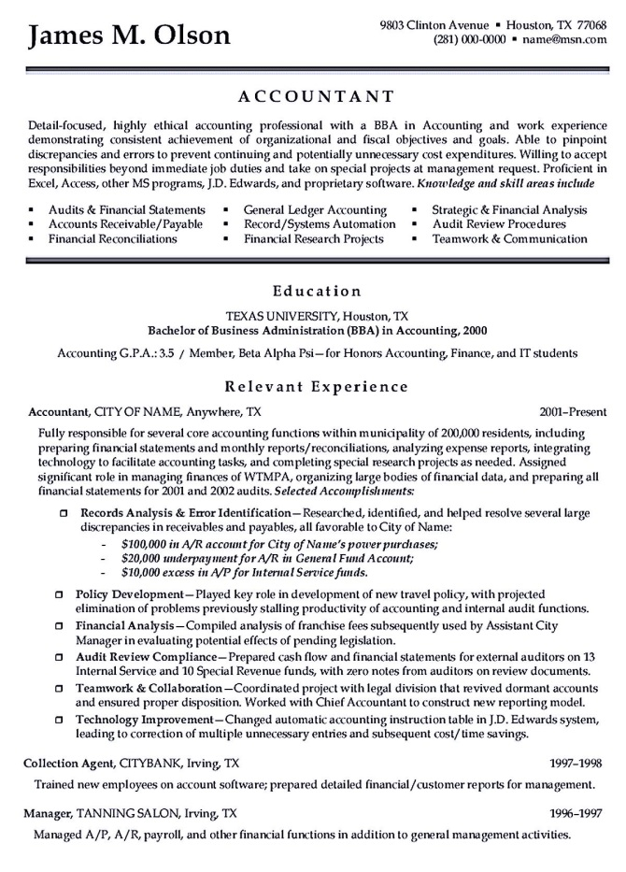
Resume
Lots of redundant and non-specific adjectives & duties
Laundry list of skills
Can’t decide between paragraphs and bullet points
Too much detail on 1 job and too little detail on others

Slide 37
Resume

Slide 38
Resume
Contact Information
Education
Experience
Additional Information

Slide 39
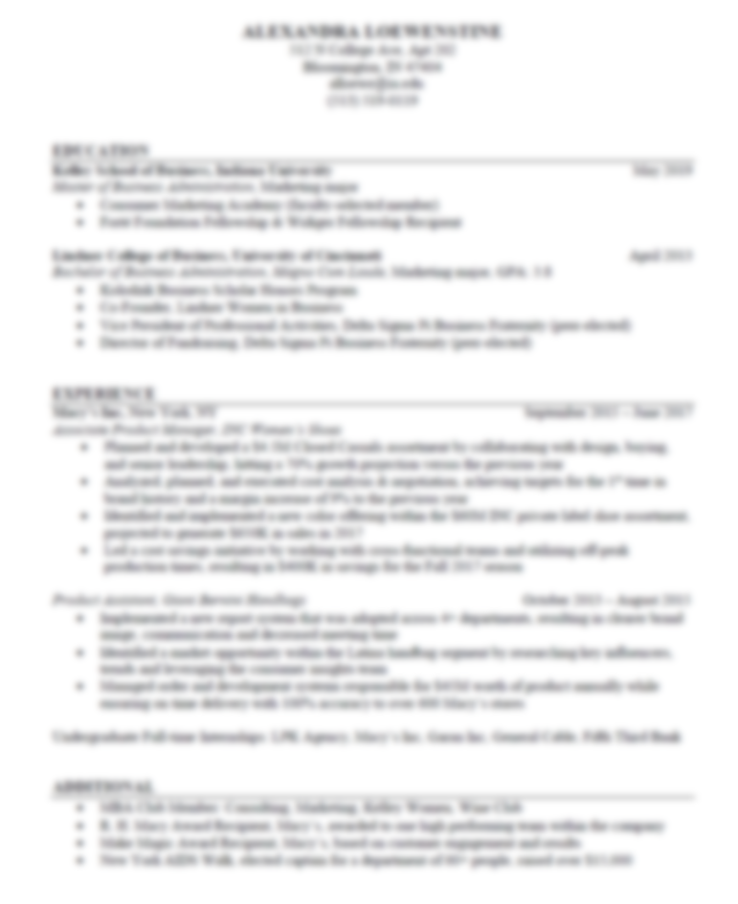
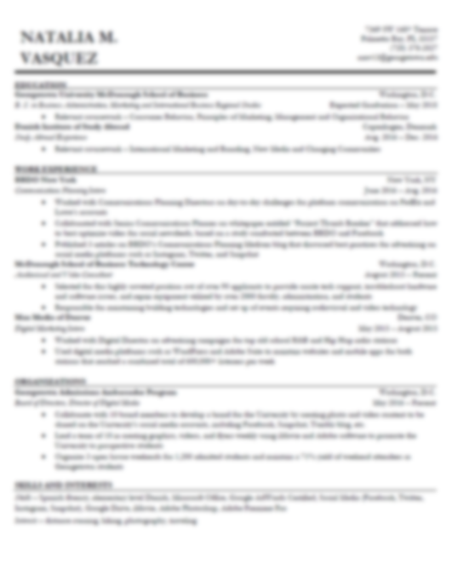
Resume

Slide 40
Resume: Section 1
Name
Address
E-mail & Phone Number
Website or LinkedIn Site (optional)

Slide 41
Resume: Section 2
COLLEGE NAME City, State
Degree Graduation Date
Activities, Honors, Awards

Slide 42
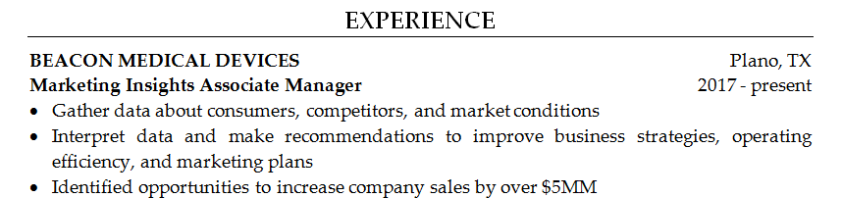
Resume: Section 3
ORGANIZATION NAME City, State
Job Title Years Worked
Activities & Results (these should match the job description)

Slide 43
Resume: Section 4
Activities
Interests

Slide 44
Resume
Contact Information
Education
Experience
Additional Information

Slide 45
Types of Interview Questions
Opening Questions
Fit Questions
Case Questions
Closing Questions

Slide 46
Types of Interview Questions
1. Opeing Questions
2. Fit Questions
3. Case Questions
4. Closing Questions

Slide 47
1. Experience Questions
Tell me about yourself.
Walk me through your resume.
Why should I hire you?
What’s been your favorite job?

Slide 48
“Facts tell, stories sell.”
Interview Secret

Slide 49
P-E-N Framework
Passion
Experience
Next

Slide 50
Passion: “I’ve always had a passion for…
… finding creative solutions to challenging problems.”
… building high-performance teams.”
… figuring out what motivates people.”
… analyzing complex issues.”
… working with diverse groups of people.”
Hint: Choose something from the job description.

Slide 51
Experience: “When I was …
… in school, I …”
… working as a _______, I …”
… on a _______ team, I …”
Hint: Use experiences related to the job description.

Slide 52
Next: “Now, I want to find a job …
… that allows me to …”
… that will give me an opportunity to …”
… where I can …”
Hint: Tell them you want to work for them next.

Slide 53
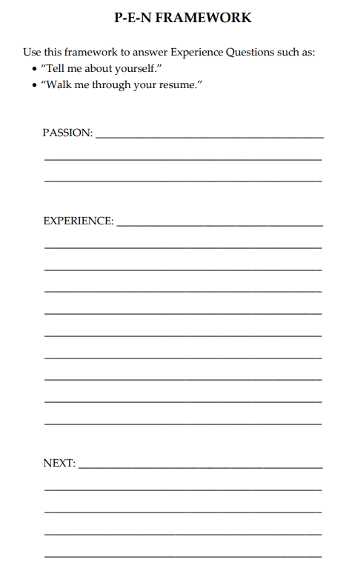
P-E-N Framework
http://amazingjobskills.com/wp-content/uploads/2017/07/Framework-templates-for-Amazing-Interview-Answers.pdf

Slide 54
Recap: Classes #1 & #2
Preferred Type of Job → Job Descriptions
Job Hunting Strategy → Tracker
3. Job Descriptions → Resumes
4. Opening Questions → P.E.N. Answer

Slide 55
This Class
Job Descriptions + Resumes
→ Cover Letters
2. Interview Answers
→ S.T.A.R. & 4P’s Answers

Slide 56
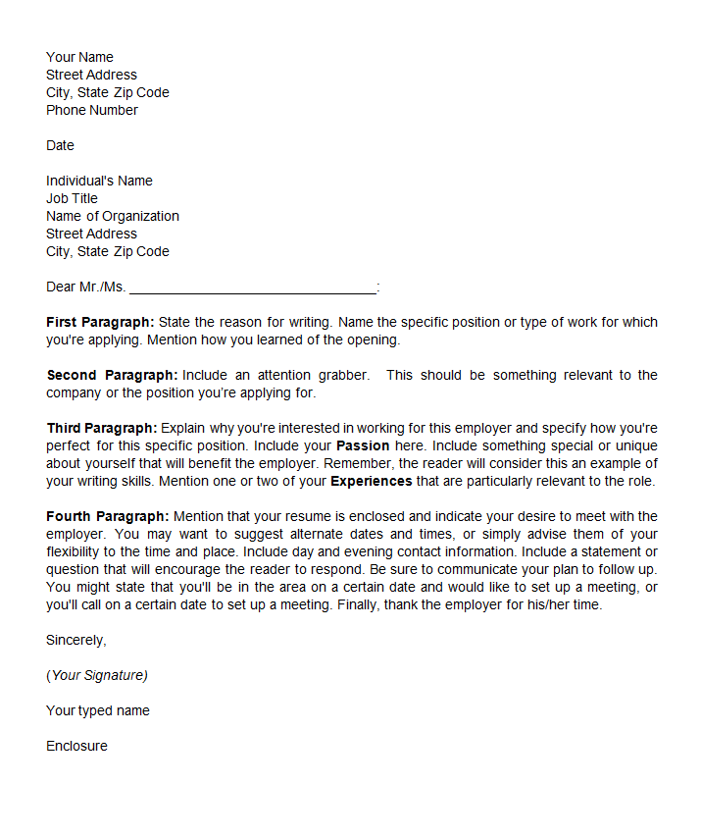
Cover Letter
Heading
Purpose of Letter
Attention Grabber
Passion & Experience
Request for Interview

Slide 57
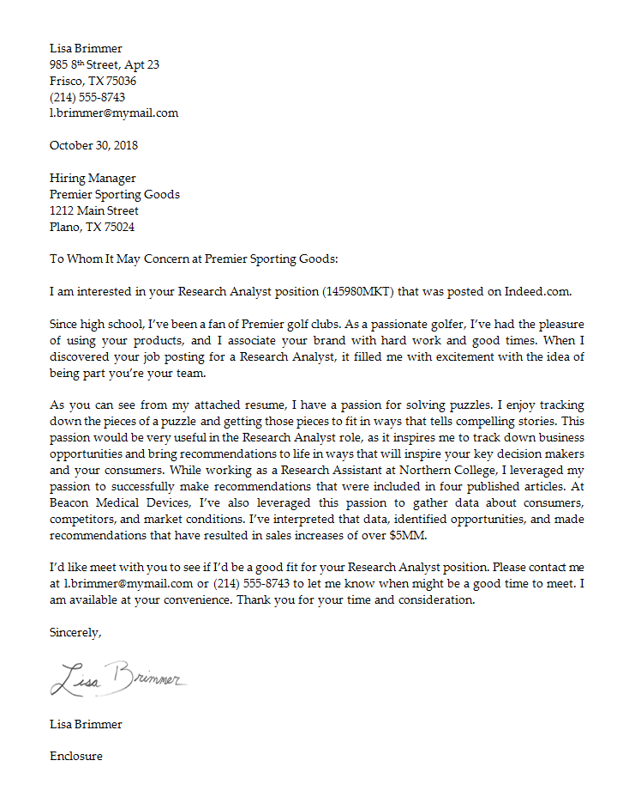
Cover Letter
Heading
Purpose of Letter
Attention Grabber
Passion & Experience
Request for Interview

Slide 58
Cover Letter: Heading
Heading

Slide 59
Cover Letter: Paragraph 1
Purpose of Letter

Slide 60
Cover Letter: Paragraph 2
Attention Grabber

Slide 61
Cover Letter: Paragraph 3
Attention Grabber

Slide 62
Cover Letter: Paragraph 4
Request for Interview

Slide 63
Cover Letter
Heading
Purpose of Letter
Attention Grabber
Passion & Experience
Request for Interview

Slide 64
This Class
Job Descriptions + Resumes
→ Cover Letters
2. Interview Answers
→ S.T.A.R. & 4P’s Answers

Slide 65
This Class
Job Descriptions + Resumes
→ Cover Letters
2. Interview Questions
→ P.E.N., S.T.A.R., and 4P’s Answers

Slide 66
Get a list of interview questions
Opening Questions
Fit Questions
Case Questions
Closing Questions

Slide 67
Types of Interview Questions
1. Experience Questions
2. Fit Questions
3. Case Questions
4. Closing Questions

Slide 68
2. Fit Questions
Tell me about a time when you demonstrated
leadership, creativity, analytical skills, etc.
What’s your greatest strength?
How would a co-worker describe you?

Slide 69
Example
“What’s your
greatest strength?”

Slide 70
Option 1 or Option 2
“What’s your greatest strength?”

Slide 71
Situation: “When I was working as a …”
S-T-A-R Framework
Task: “… my assignment was to …”
Actions: “First, I … Then, I … Finally, I …”
Result: “As a result, …”

Slide 72
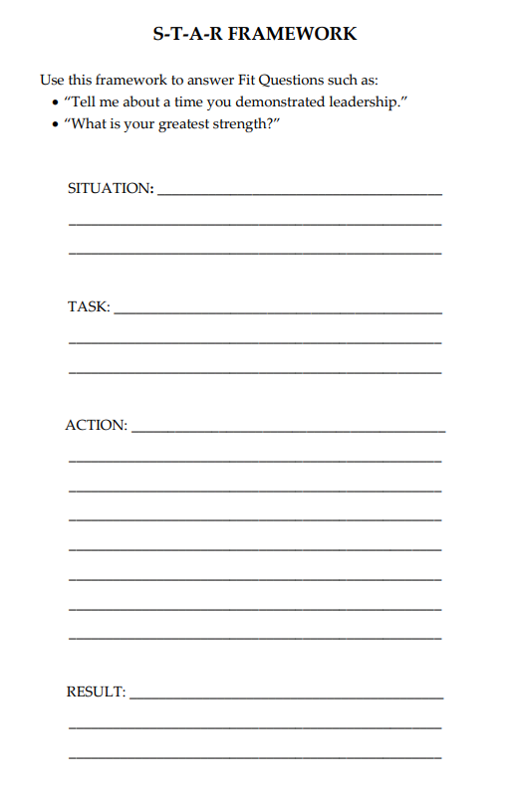
S-T-A-R Framework
http://amazingjobskills.com/wp-content/uploads/2017/07/Framework-templates-for-Amazing-Interview-Answers.pdf

Slide 73
Types of Interview Questions
1. Experience Questions
2. Fit Questions
3. Case Questions
4. Closing Questions

Slide 74
Example
“You’re working on a snack brand,
and your sales are down 20%.
What do you do?”

Slide 75
Option 1 or Option 2
“… develop a new product. What first?”

Slide 76
4-P’s Framework
Product
Placement
Pricing
Promotion

Slide 77
Product
Has something changed with my product?
Have my competitors changed their products?

Slide 78
Placement
Is anything changing where I sell my product? Traffic? Shelf-space?
What is happening with distribution for my competitors?

Slide 79
Pricing
Have I changed my pricing?
Have my competitors changed their pricing?
Have consumers become more or less price sensitive?

Slide 80
Promotions
Have I changed my marketing tactics, message, or spend?
Is my marketing message effective?
What promotions are my competitors doing?

Slide 81
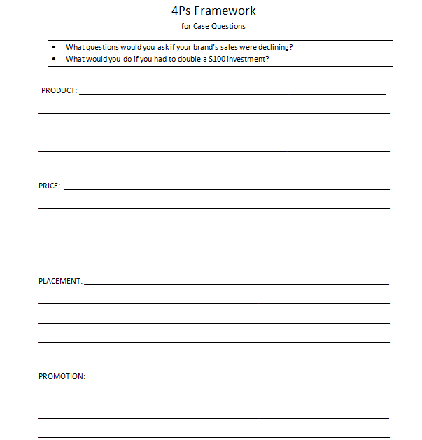
4Ps Framework
http://amazingjobskills.com/wp-content/uploads/2017/07/Framework-templates-for-Amazing-Interview-Answers.pdf

Slide 82
Types of Interview Questions
1. Experience Questions
2. Fit Questions
3. Case Questions
4. Closing Questions

Slide 83
Is there anything else I should know about you?
Tell your best S-T-A-R story
that you haven’t told yet.

Slide 84
What questions do you have for me?
What do you like most
about working at PepsiCo?
vs.
What do you like least
about working at PepsiCo?

Slide 85
What questions do you have for me?
What characteristics are most important
for someone succeeding in this role?
vs.
What could cause someone to be
unsuccessful in this role?

Slide 86
What questions do you have for me?
Why did you choose to work
for this company?
vs.
What are the biggest challenges
you face in your role?

Slide 87
Get a list of interview questions
Opening Questions
Fit Questions
Case Questions
Closing Questions

Slide 88
Question: What do recruiters look for?

Slide 89
Answer: What recruiters look for:
Positive
Passionate
Consumer Focus
Highly collaborative
Thrive in ambiguity
Leadership with results
Can you market yourself?

