Slide 1
How to Motivate Students … Their Way Richard Blazevich A Recruiter’s Perspective December 2019

Slide 2
Show of Hands

Slide 3
My Storyvv

Slide 4
I've Been Marketing to College Students for 20 Years

Slide 6
?

Slide 7
Quiz: Biggest Challenge for Dallas-Based Students?
Previous Work Experience
Resume Structure & Format
Online Profiles
Networking
Interview Answers
Other ___________

Slide 8
My Journey
Marketing & Recruiting
Career Swtich

Slide 9
My Journey
Career Speaking & Publishing
Marketing & Recruiting

Slide 10
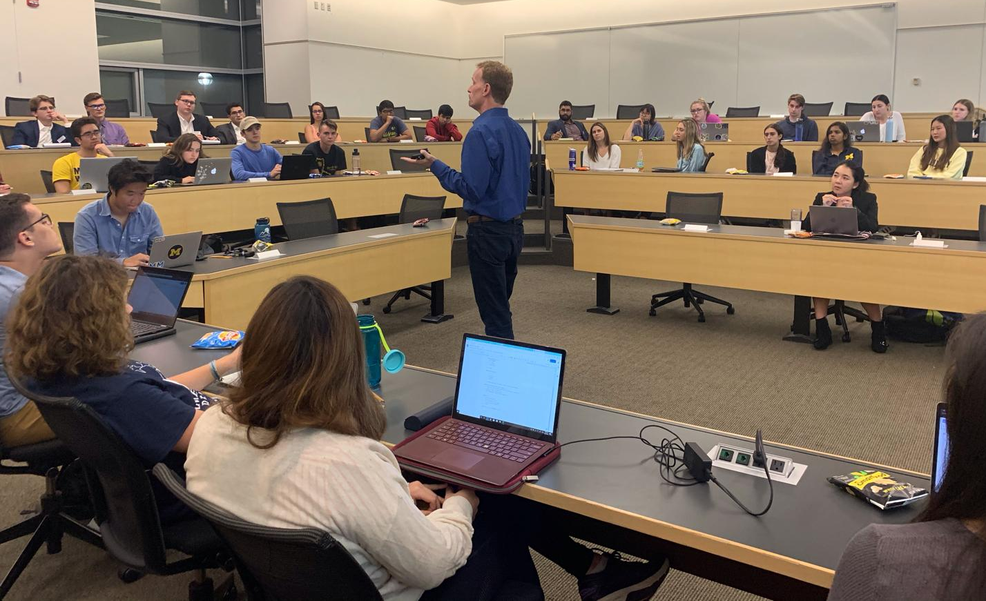

Slide 14
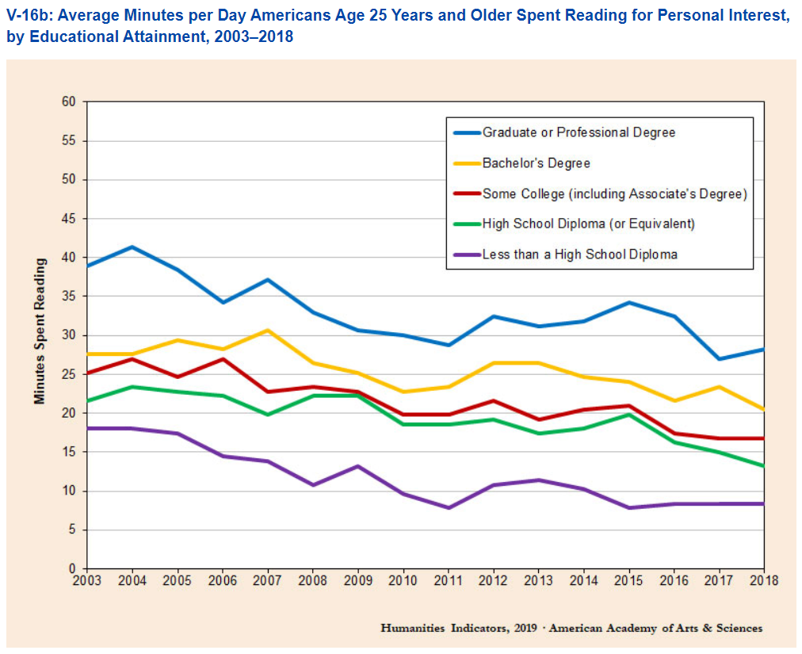
Average Minutes per Day Americans Spent Reading
MOOC = Massive Open Online Courses

Slide 15
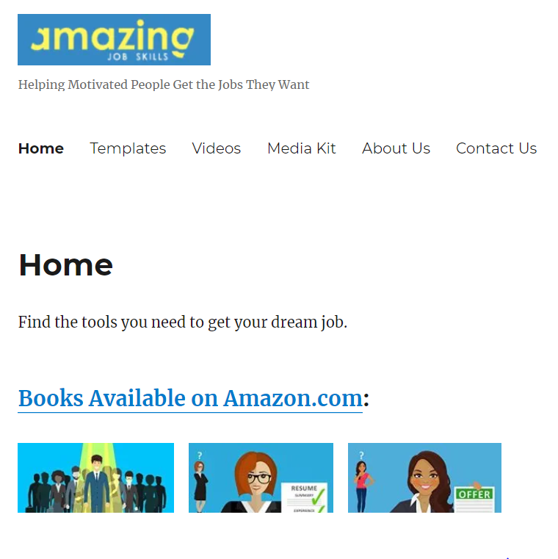
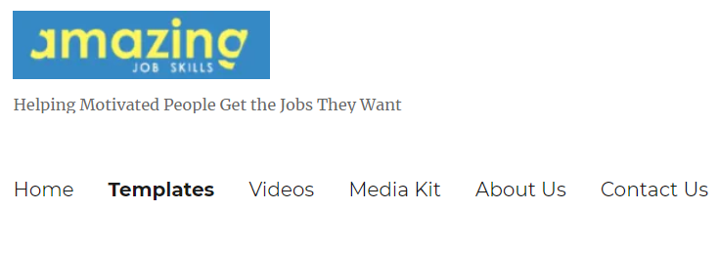
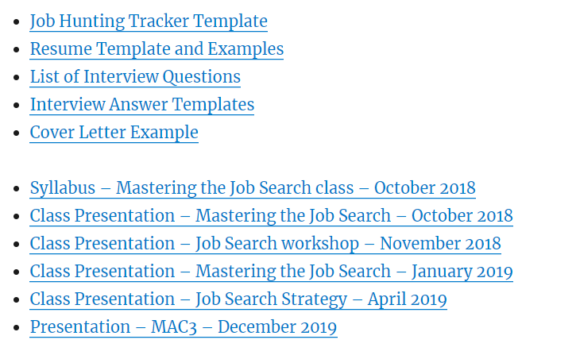
Download This Presentation at www.AmazingJobSkills.com

Slide 16
How I Learned

Slide 17
How the Younger Generation Interacts

Slide 18
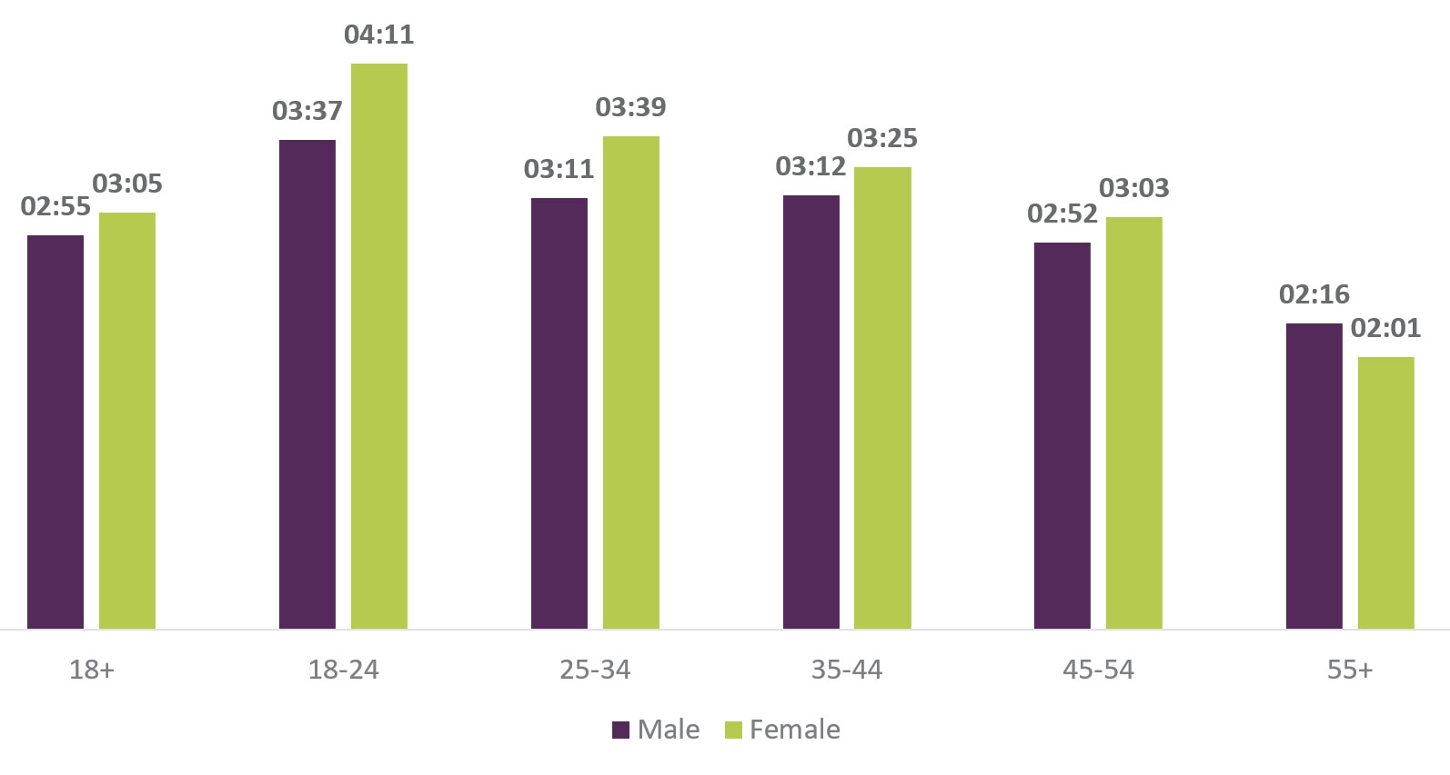
People age 18-24 spend more time on their phones than any other age group
Average Smartphone Time Usage/Day (Hours:Minutes)
2018
Source: Ofcom Media Research

Slide 19
What Are They Doing on Their Phones?

Slide 20
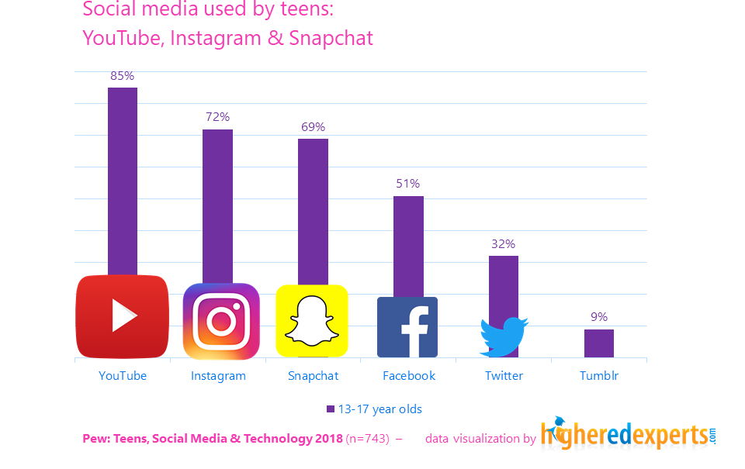
How the People Watch Videos
Top 3rd Party Apps Used by Teens

Slide 21
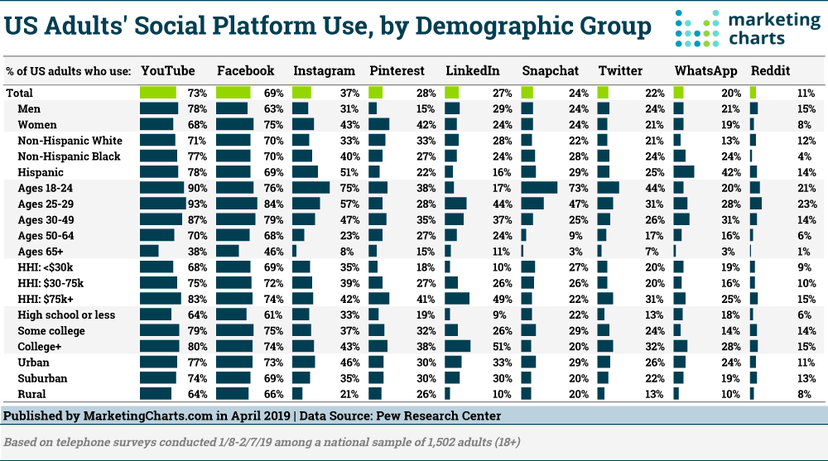
How the People Watch Videos

Slide 22
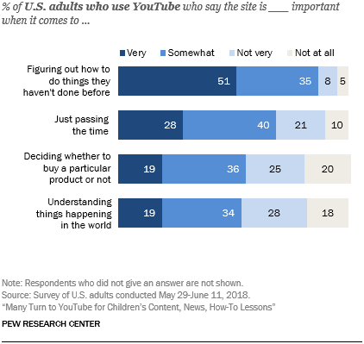
The #1 Reason for Using YouTube Is to Figure out How to Do New Things

Slide 23
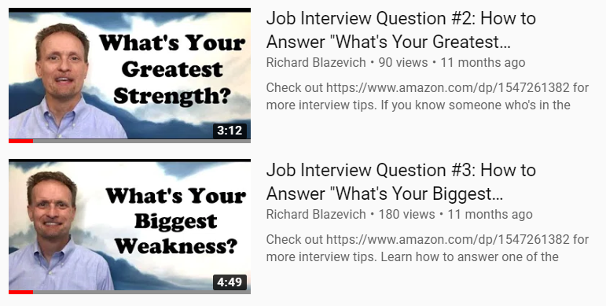
So I Started Using YouTube to Reach Students

Slide 24
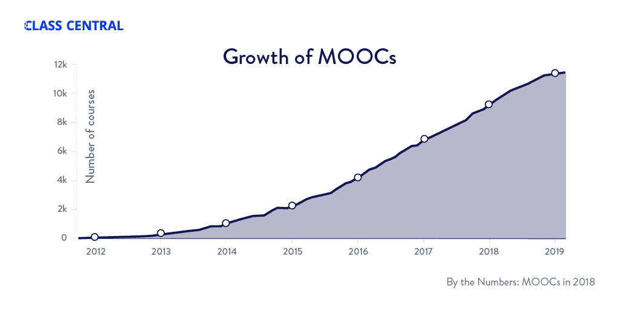
Then I Learned About Online Courses
MOOC = Massive Open Online Courses

Slide 25
Increasingly, Students Blend Online and On-Campus
Student-Reported Online Course Formats
Source: BestColleges.com, 2019 Online Education Trends Report

Slide 26
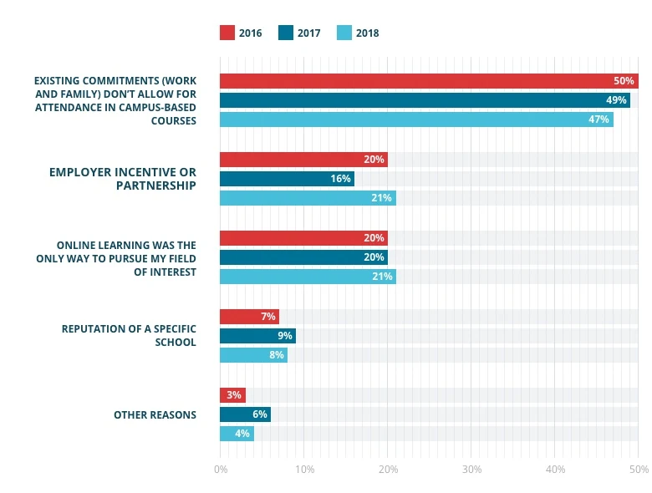
The Main Benefit of Online Classes is Convenience
Reasons for Choosing Online Course vs. On-Campus Classes
Source: BestColleges.com, 2019 Online Education Trends Report

Slide 27
Then I Learned About Online Courses
Student-Reported Concerns
About Choosing Online Courses vs. On-Campus Courses
32%
18%
23%
9%
17%
No
Concerns
Perception of
Online Degree
Among Employers
Quality of
Instruction
& Support
Challenge
Using
Technology
Lack of
Interaction
w/ Instructors
& Students
Source: BestColleges.com, 2019 Online Education Trends Report

Slide 28
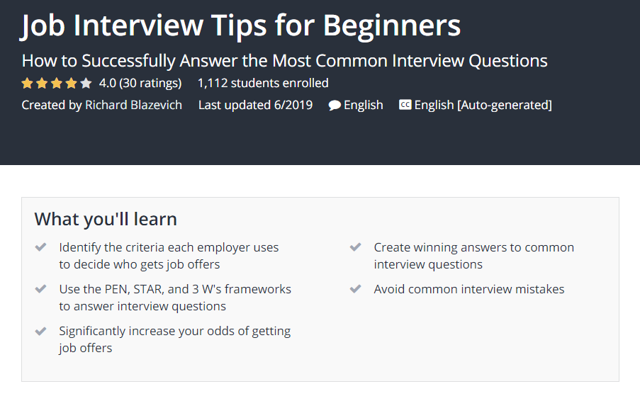

Slide 31
Quiz: Your School’s Online Platforms
Handshake
Canvas
LinkedIn Learning / Lynda.com
Udemy
Skillshare
Other: ___________
?

Slide 32
Online Course Landscape
External Platform
Pay Per Class
External Platform
Subscription Based
Internal Platform
File Sharing

Slide 33
SMU Pilot Program: Topics Included
Module 1: Pick Your Career Path
Module 2: Build Your Search Strategy
Module 3: Write Your Winning Resume
Module 4: Build Your LinkedIn Profile
Module 5: Build Your Interview Skills
other topics tbd

Slide 34
Recruiter: “I wish there was an easier way to meet students I might want to interview.”

Slide 35
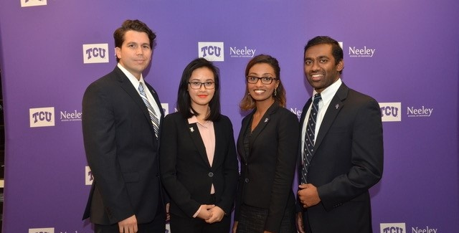
Who’s up for a little friendly competition?

Slide 36
Quiz: Which of These Options Interest You
Online Classes
Pre-Recorded Student Interviews
Interview Case Competitions
Other ___________

Slide 37
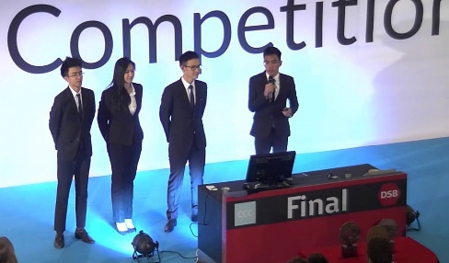
If you want to participate …
Email me at
RichardB@AmazingJobSkills.com
A
Online
Classes
B
Prerecorded
Interviews
C
Interview
Competitions
D
Your Own
Idea

