Slide 1
Mastering the Job Search
Richard Blazevich
February 2020

Slide 3
Who Am I?

Slide 4
What’s My Story?

Slide 5
The Turning Point …

Slide 6
Best Advice Ever

Slide 7
Recruiting

Slide 8
What’s Next

Slide 9
What Do Recruiters Look For?

Slide 10
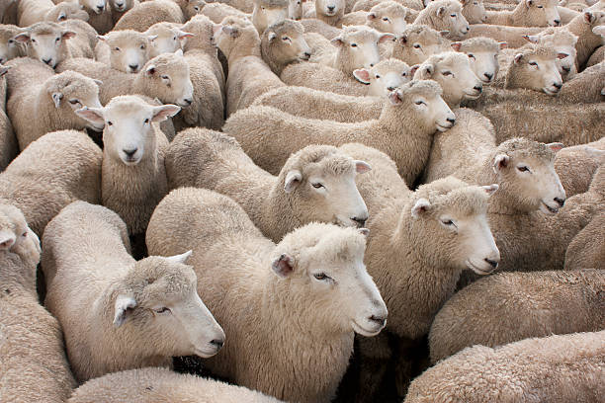
What Recruiters Look for

Slide 11
Your Secret Weapon
teach
plan
duties
write
skills
recommend
present
JOB
DESCRIPTION
coordinate
education
manage
experience
responsibilities
job title
requirements
design
lead
build
program
prepare

Slide 12
How the Hiring Process Works
Employer
Identifies
Job
Opening
Employer
Posts Job w/ Job Description
Candidates Apply
for
Job
Employer
Screens for
Qualified Candidates
Employer
Interviews & Hires Qualified Candidates
Screens for
Qualified Candidates
Job Description

Slide 13
How Employers Screen Applicants

Slide 14
How Employers Screen Resumes
Resume
Resume
Resume
Resume
Resume
Resume
ATS Screening Software
Resume

Slide 15
How do employers screen resumes?
match

Slide 16
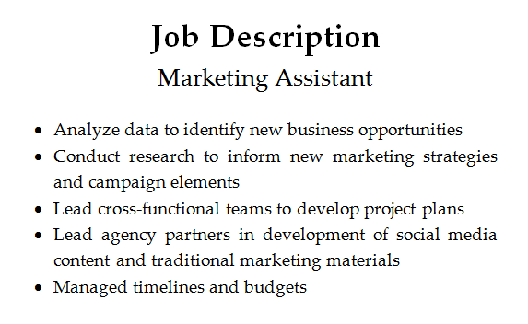
How Employers Screen Applicants

Slide 17
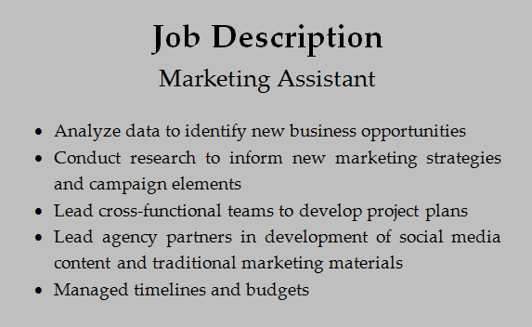
How Employers Screen Applicants
Analyze data
Conduct research
Lead cross-functional teams
Lead agency partners
Manage timelines and budgets

Slide 18
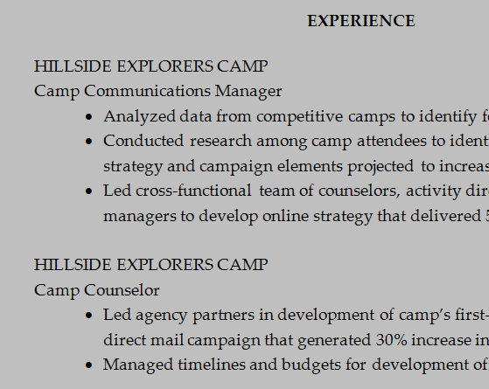
How Employers Screen Applicants
Analyzed data
Conducted research
Analyze data
Conduct research
Led cross-functional teams
Lead cross-functional teams
Lead agency partners
Manage timelines and budgets
Led agency partners
Managed timelines and budgets

Slide 19
Other Resumes

Slide 20
How do employers screen resumes?
Your Resume
Other Resumes

Slide 21
How Should You Answer Interview Questions?

Slide 22
Your Secret Weapon
teach
plan
duties
write
skills
recommend
present
JOB
DESCRIPTION
coordinate
education
manage
experience
responsibilities
job title
requirements
design
lead
build
program
prepare

Slide 23
What Recruiters Look for
Positive
Passionate
Collaborative
Customer Focus
Thrive in Ambiguity
Leadership with Results
Can You Do the Job?

Slide 24
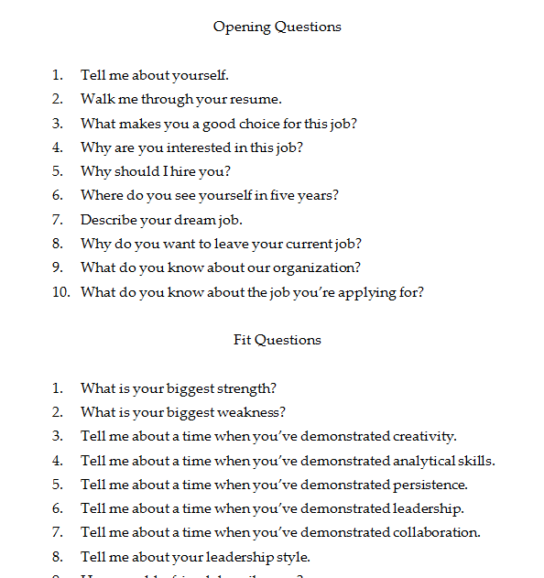
Get a List of Interview Questions

Slide 25
Option 1 or Option 2
Opening Questions
“Tell Me
About
Yourself”

Slide 26
Opening Questions
Passion
“Tell Me
About
Yourself”
Experience
Next

Slide 27
Fit Questions
Option 1 or Option 2
“Tell Me
About a
Time When
…”

Slide 28
Your Secret Weapon
teach
plan
duties
write
skills
recommend
present
JOB
DESCRIPTION
coordinate
education
manage
experience
responsibilities
job title
requirements
design
lead
build
program
prepare

Slide 29
Fit Questions
Situation: “When I was working as a …”
Task: “… my assignment was to …”
Actions: “First, I … Then, I … Finally, I …”
Result: “As a result, …”

Slide 30
Closing Questions
Is there anything else
I should know about you?
What questions do you have for me?

Slide 31
Story Time

Slide 32
Anyone up for a Challenge?

Slide 33
What’s Next

Slide 34
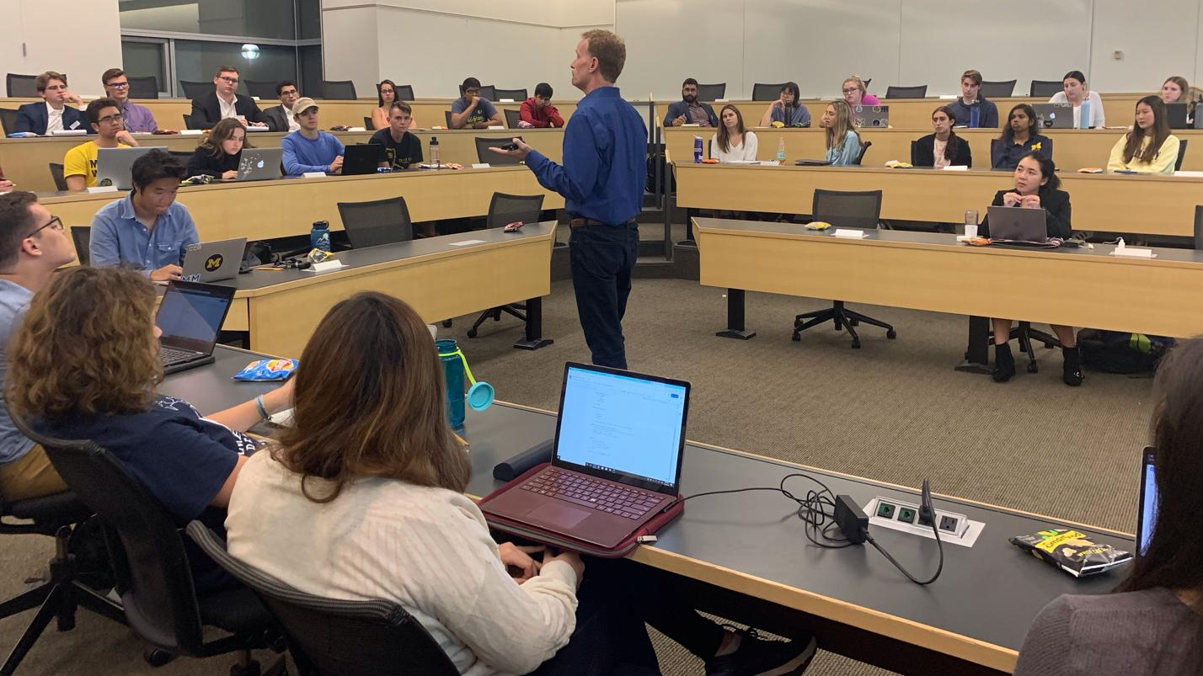

Slide 35
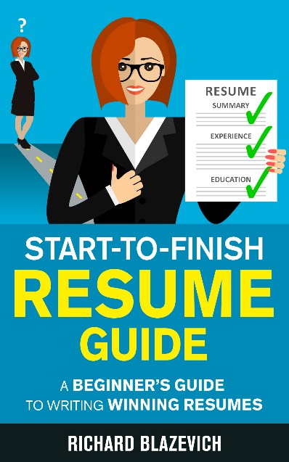
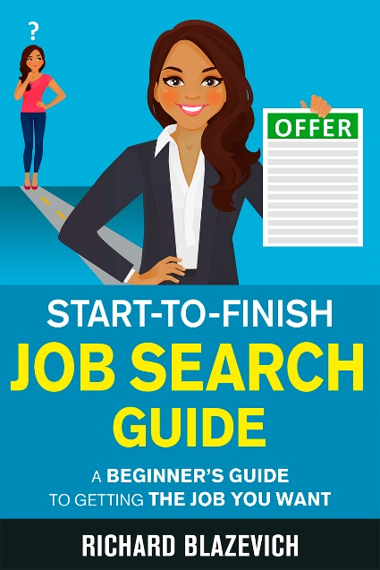

Slide 36
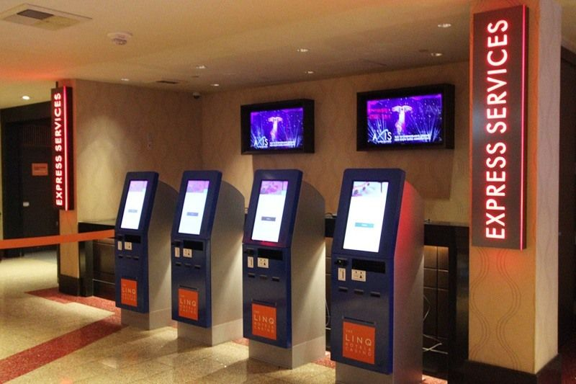
How People Prefer to Interact

Slide 37
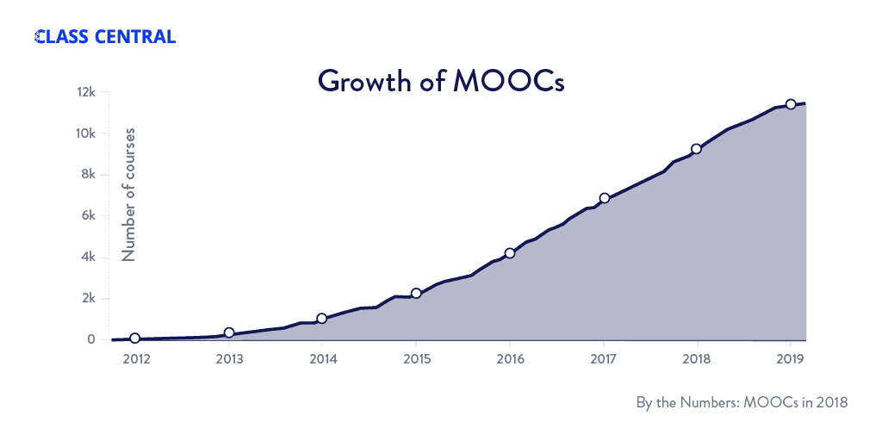
Growth of Online Courses
MOOC = Massive Open Online Courses

Slide 38
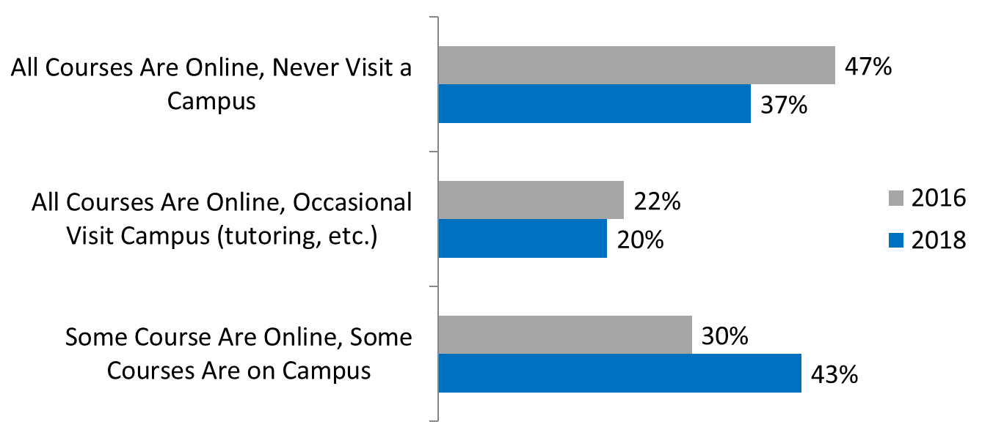
Blending Online and On-Campus
Student-Reported Online Course Formats
Source: BestColleges.com, 2019 Online Education Trends Report

Slide 39
Join My Pilot Test
Email me at
RBlazevich@CareerCourseAcademy.com
7 Modules Covering:
Job Search Strategy
Resume Writing
LinkedIn Profiles
Interview Answers
and more

