Slide 1
Career Management Module
Session 3
Spring 2020

Slide 2


Notes:
Warm up question to get the class engaged:
Could be “how many freshmen, sophomores, etc.” or “how many marketing, finance, etc.”

Slide 3
Topics FOR TODAY
Types of Interviews
What Recruiters Look for
How to Answer Interview Questions
  Opening Questions
  Behavior Questions
  Class Exercise
  Case Questions
  Closing Questions
Interview Checklist

Slide 4

Who Am I?

Slide 5

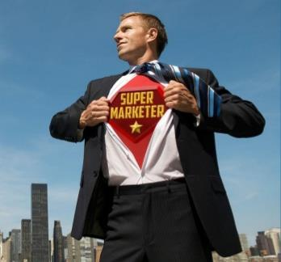
My Story

Slide 6

My Turning Point

Slide 7

Best Advice Ever

Slide 8

My Recruiting job

Slide 9

What’s Next

Slide 10
Types of
Interviews

Slide 11
The Hiring Process
Employer
Identifies
Job
Opening
Employer
Posts Job w/ Job Description
Candidates Apply
for
Job
Employer
Screens for
Qualified Candidates
Employer
Interviews Candidates &
Makes Job Offers
Phone Screen
Round 1
Round 2
Basic
Qualifications
Behavioral
Questions
Case
Questions

Slide 12
Interview types
Phone Screen:
Hiring Manager vs. HR
20 minutes
Behavioral Interviews:
“STAR” Format
20-60 minutes
Virtual Interviews:
Recording vs Skype
30 minutes
Case Interviews:
Job simulation assessing your problem-solving approach
Technical Interview
Gauge technical competencies
Group/Panel Interview
Multiple interviewers vs. interviewees
Lunch/Dinner Interview
Best approach
Right answer
Cultural fit assessment
Notes:
LAURIE – MAKE PRETTY SLIDE

Slide 13
What Employers
Look For

Slide 14



Phone Screens
Candidate
Candidate
Candidate
Candidate
Candidate
Candidate
Phone
Screen
Candidate

Slide 15

How do employers screen resumes?
match

Slide 16
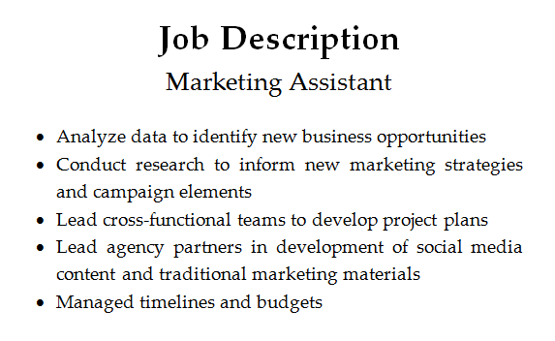
Experience ScreeninG

Slide 17
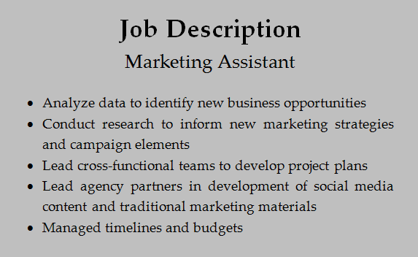
Key Words
Analyze data
Conduct research
Lead cross-functional teams
Lead agency partners
Manage timelines and budgets

Slide 18


Other Candidates

Slide 19
How do employers screen resumes?
You
Other Candidates

Slide 20
Types of
Interview Questions

Slide 21
Types of Questions
Opening Questions
Behavior Questions
Case Questions
Closing Questions

Slide 22
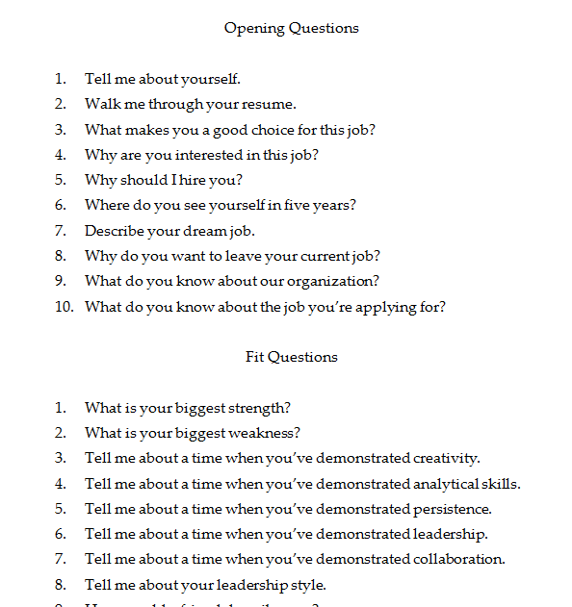
Interview Questions

Slide 23
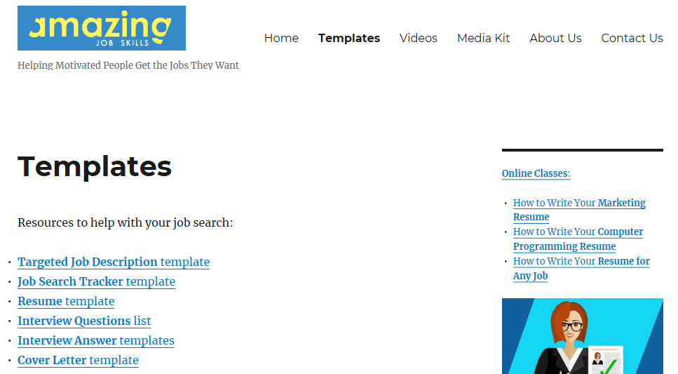
Interview Questions
www.AmazingJobSkills.com > Templates page

Slide 24
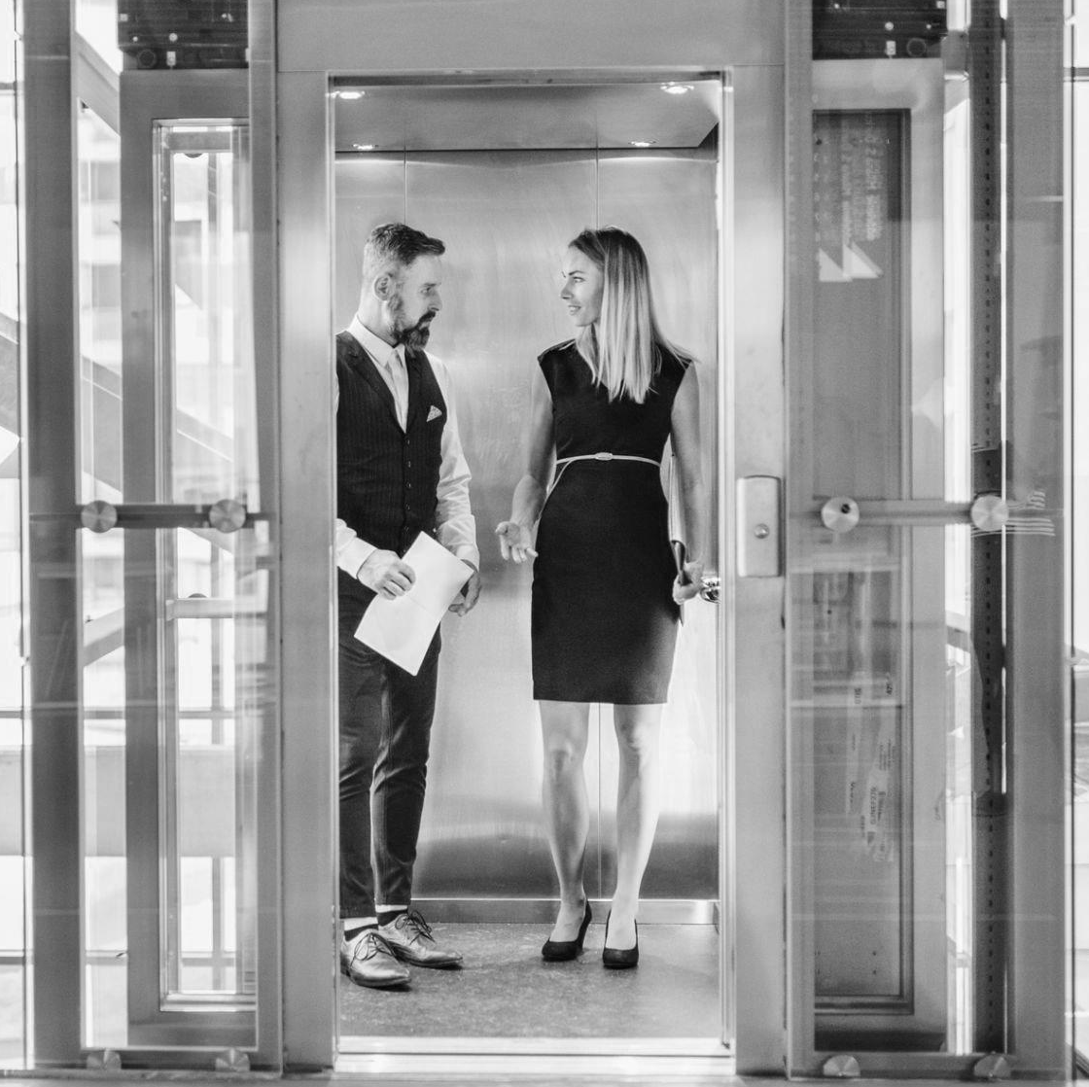

TELL ME
ABOUT
YOURSELF
Highly tailored Sales pitch
Structure: 30-45 seconds
Passion: 1 sentence
Experience: 2 or 3 examples
Next: 1 sentence
Should align with role / company
Notes:
LINKS TO VIDEOS

Slide 25
Option 1 or
Option 2
Opening Questions
“Tell Me
About
Yourself”

Slide 26
Opening Questions
Passion
“Tell Me
About
Yourself”
Experience
Next

Slide 27
Class ACTIVITY
Pair up with someone near you
Prepare your response to “Tell me about yourself”
Tell your answer to the class
Passion: “I have a passion for …”
Experience: “Here are a few things I’ve done …”
Next: “Now, I’m looking for opportunities to …”

Slide 28

Why do you want to work here?
Company
  Culture / personality
  growth
role
  Why you want THIS job
  How you can drive impact
  How you will grow

Slide 29
Behavior Questions
Option 1
or
Option 2
“Tell Me
About a
Time When
…”

Slide 30
Your Secret Weapon
plan
write
duties
skills
analyze
recommend
present
JOB
DESCRIPTION
develop
education
manage
experience
responsibilities
job title
requirements
design
lead
build
program
prepare

Slide 31
Behavior Questions
Situation: “When I was working as a …”
Task: “… my assignment was to …”
Actions: “First, I … Then, I … Finally, I …”
Result: “As a result, …”

Slide 32
Class ACTIVITY
Pair up with someone near you
Prepare your answer to “What’s your biggest accomplishment?”
Tell your answer to the class
Situation: “When I was working as a …”
Task: “… my assignment was to …”
Actions: “First, I … Then, I … Finally, I …”
Result: “As a result, …”

Slide 33

strengths
  Should align specifically with company & role
  "I DO" vs. "I did"
  DIFFERENT APPROACHES BASED ON QUESTION type
  "GREATEST STRENGTH" = START
  "TOP X STRENGTHS" = SYNOPSIS

Slide 34
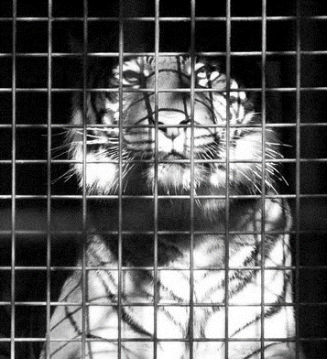
Weaknesses:
Know thyself
Something you naturally do (or don't do) that you have learned to control
How you specifically control it
Cannot violate the don'ts
Avoid clichés

Slide 35
Closing Questions
Is there anything else
I should know about you?
What questions do you have for me?

Slide 36

Finish strong
Tell them you want the job (ask for the sale)
Firm handshake – look your interviewer in the eyes
SMILE

Slide 37
Interview
Checklist

Slide 38
Pre-interview checklist
Prepare Yourself!
Know your Story
Know the Job
Know the Employer
Know your Resume
Ask:
What is the interview process?
What is the interview schedule?
What will be the interview structure, format, and medium?
With whom are you interviewing?
When will they make decisions?
When is the target start date ?
What general advice can they provide?
What is your “why”?

Slide 39
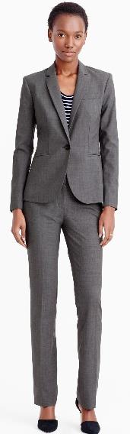
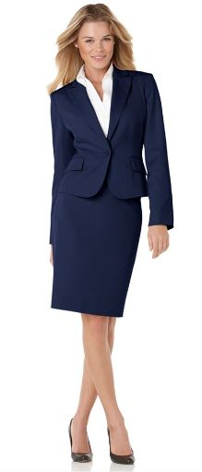
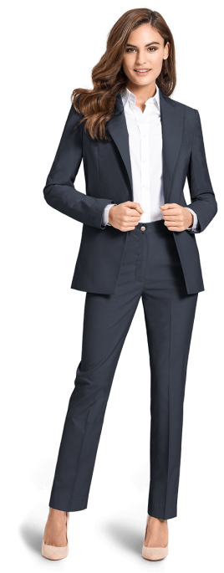
Women’s interview attire
SUIT: TWO-PIECE MATCHING – NAVY, GREY, BLACK
SHIRT/BLOUSE: QUALITY MATERIAL, NOT SEE-THROUGH OR LOW-CUT
SKIRT/PANTS: SKIRTS SHOULD BE APPROPRIATE LENGTH (COVERING THIGHS WHEN SEATED); PANTS CUFFS SHOULD BE HEMMED; EITHER MUST MATCH JACKET (BOUGHT TOGETHER)
TIGHTS: PLAIN OR SHEER; NEUTRAL COLOR TO COMPLIMENT SUIT
SHOES: LEATHER PUMP IN A COLOR THAT MATCHES SUIT (BLACK WITH BLACK OR GRAY, NEUTRAL WITH NAVY; MEDIUM HEEL
ACCESSORIES: SUBTLE MAKEUP; SENSIBLE, NEUTRAL NAIL POLISH OR NONE; CONSERVATIVE JEWELRY; SIMPLE BAG; NO VISIBLE TATTOOS; REMOVE VISIBLE PIERCINGS OTHER THAN EARS

Slide 40
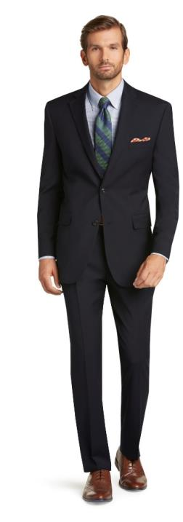
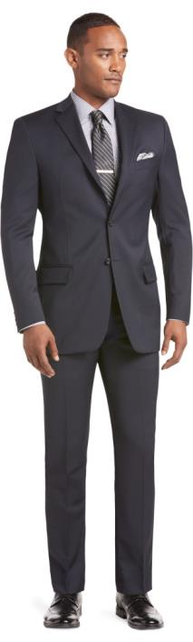
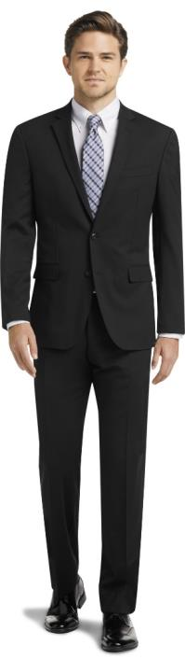
men’s interview attire
SUIT: TWO-PIECE MATCHING IN NAVY, DARK GRAY, OR BLACK; SOLID OR VERY SUBTLE PATTERN; TAILORED; TWO OR THREE BUTTON
SHIRT: LONG-SLEEVE, WHITE OR LIGHT BLUE; SOLID OR SUBTLE, CONSERVATIVE PATTERN
TIE: HIGH QUALITY SILK; SOLID, STRIPES, OR CONSERVATIVE PATTERN; WINDSOR OR HALF WINDSOR
SHOES: BLACK OR BROWN LEATHER - SHOULD MATCH BELT; CONSERVATIVE STYLE; POLISHED
SOCKS: SHOULD MATCH PANTS OR SHOES
ACCESSORIES: SIMPLE WATCH, NO JEWELRY OTHER THAN WEDDING / CLASS RING; NO VISIBLE TATTOOS OR PIERCINGS

Slide 41

Interview confidently
Body language:
  Sit up straight, never slouch in the chair
  Maintain good eye contact, smile and be congenial
  Don’t fidget with your hair, tie, jewelry, fingers/fingernails
Positive language:
  Be positive about yourself, past employer and the future
  Make sure the interviewer knows you are excited about the positions and the organization
General tips:
  Have extra copies of resume
  Complete application if you have received it prior to interview
  Prepare questions to ask interviewer
  Bring paper for writing notes
Notes:
Non-Verbal:
Eye contact
Handshake
Open vs. closed posture
Active Listening
Smile!
Pay attention-Turn off your phone
Verbal:
Introduce yourself
State your purpose
Provide essential information
Ask for advice/ guidance
Use formal English
Components of communication: verbal…non-verbal
Nametag…right lapel.
In general, people want to help. Make it easy for them by providing clear and concise information.

Slide 42

After the interview
Send values-based “thank you” card by mail to confirm your interest within 24-48 hours
Take post-interview notes and reflect on your performance – What did you learn?
If you haven’t heard back, follow up after 7 business days
Put reminder for 2nd follow-up for 2 weeks to 1 month from 1st follow-up thank you email
Thank You Note Example:
“Thank you for taking the time to meet today… Here is why I would be an outstanding employee… I would appreciate the opportunity to speak with you further…”

Slide 43
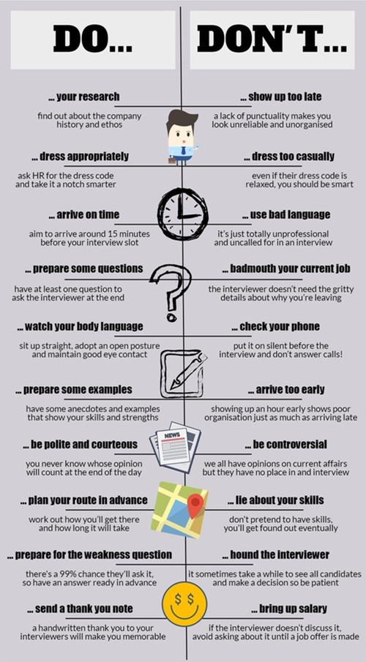
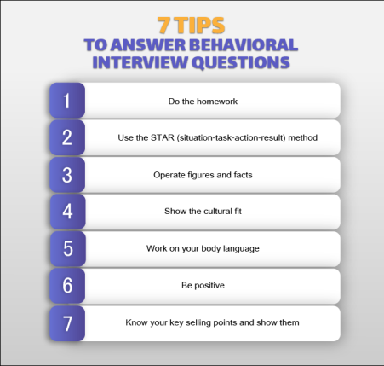

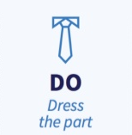

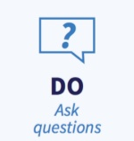
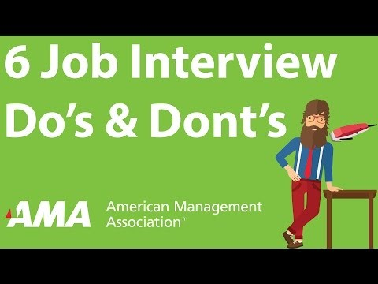




Interview DOS & don’ts
Notes:
Laurie – funny video on interview do’s don’t’s
https://www.bing.com/videos/search?q=interview+do%27s+don%27ts&ru=%2fvideos%2fsearch%3fq%3dinterview%2bdo%2527s%2bdon%2527ts%26FORM%3dHDRSC3&view=detail&mid=4B335C1D02E1B7E3CC004B335C1D02E1B7E3CC00&&FORM=VDRVRV
https://www.bing.com/videos/search?q=do%27s+don%27ts+job+interview&&view=detail&mid=E257FDFF8E934AD7E32DE257FDFF8E934AD7E32D&&FORM=VRDGAR&ru=%2Fvideos%2Fsearch%3Fq%3Ddo's%2520don'ts%2520job%2520interview%26qs%3DRI%26form%3DQBVDMH%26sp%3D4%26pq%3Dinterview%2520do's%2520don'ts%26sk%3DHS1RI2%26sc%3D8-21%26cvid%3D79F1D62A94454E85B615AE732C6D3592
https://www.bing.com/videos/search?q=interview+do%27s+don%27ts&ru=%2fvideos%2fsearch%3fq%3dinterview%2520do%2527s%2520don%2527ts%26qs%3dn%26form%3dQBVDMH%26sp%3d-1%26pq%3dinterview%2520do%2527s%2520don%2527ts%26sc%3d8-21%26sk%3d%26cvid%3d166B80CC3BB34D889D918A0D90B730ED&view=detail&mid=0B3F31D51C9094C59E0C0B3F31D51C9094C59E0C&rvsmid=BA77CB27A87E48F948AEBA77CB27A87E48F948AE&FORM=VDRVRV
https://www.bing.com/videos/search?q=interview+do%27s+don%27ts&&view=detail&mid=C7F4730B4A4B94C6EDAAC7F4730B4A4B94C6EDAA&&FORM=VRDGAR&ru=%2Fvideos%2Fsearch%3Fq%3Dinterview%2520do%2527s%2520don%2527ts%26qs%3Dn%26form%3DQBVDMH%26sp%3D-1%26pq%3Dinterview%2520do%2527s%2520don%2527ts%26sc%3D8-21%26sk%3D%26cvid%3D166B80CC3BB34D889D918A0D90B730ED
https://youtu.be/hsxV7OmsPvQ
Components of communication: verbal…non-verbal
Nametag…right lapel.
In general, people want to help. Make it easy for them by providing clear and concise information.
Non-Verbal:
Eye contact
Handshake
Open vs. closed posture
Active Listening
Smile!
Pay attention-Turn off your phone
Verbal:
Introduce yourself
State your purpose
Provide essential information
Ask for advice/ guidance
Use formal English

Slide 44
Topics FOR TODAY
Types of Interviews
What Recruiters Look for
How to Answer Interview Questions
  Opening Questions
  Behavior Questions
  Class Exercise
  Case Questions
  Closing Questions
Interview Checklist

Slide 45
APPENDIX

Slide 46
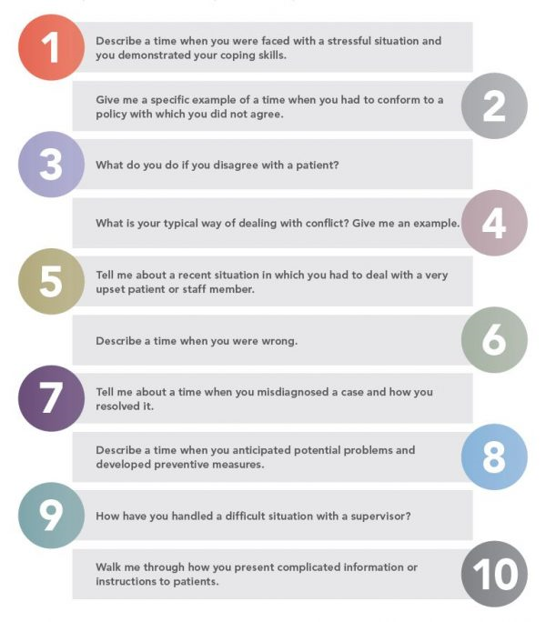
Common interview questions
Examples can include experiences from:​
  jobs and internships​
  classes, school projects​
  on and off campus activities​
  team participation​
  community service
Notes:
LAURIE
Examples can include experiences from:
jobs and internships
classes, school projects
on and off campus activities
team participation
community service
Tell me about a time when you had to manage multiple responsibilities. How did you handle that?
Let’s say you need something important from a coworker and that person isn’t responding. How would you deal with this?
We all deal with difficult customers from time to time. Tell me about a challenging client-facing situation and how you handled it

Slide 47

S•t•a•r•t
"Tell me about a time when…"
"For example"
HOW & WHY ARE VITAL
Common categories
Analysis
Leadership
Communication
Overcoming adversity
Persuasion
Failure
Difficult people
Ethical dilemma

Slide 48
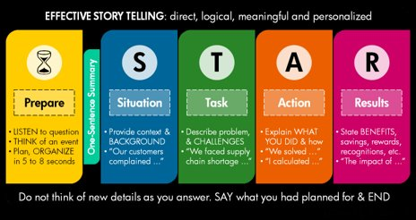









The s.t.a.r.t method
Approximately 2 minutes
action
task
result
S•T•A•R•T
situation
Tie-back
Take-Away

Slide 49
Prepare thoughtful questions
Generic
tailored
Who Will I get to work with in this role?
I know ExxonMobil’s controllers organization can support many different business units – can you tell me the typical points of contact in those business units, and if there are differences, for example, between how the Upstream and Downstream businesses engage the finance team?
What are the company’s values? What characteristics do you look for in employees in order to represent those values?
Johnson & Johnson’s credo appears to be a key driver in how the company conducts its business. One area that stood out to me was encouraging employees to make suggestions. Can you tell me how you see that value manifested in day-to-day operations?
What do you see as the most challenging aspect of this job?
Can you tell me how the challenges change as someone moves from consultant to senior consultant to Manager, and what role does Deloitte university play in ensuring the right skills are in place to succeed?
Glassdoor – 8 questions you should absolutely ask an interviewer
Notes:
would you rather your interviewer think that you just googled “questions to ask an interviewer” or that you put some serious effort into researching their company and formulating specific questions?

Slide 50



2 – 2 – 2 Rule
Industry (x2)
There appears to be a significant amount of M&A activity in the energy sector due to the recent decline in oil prices - do you think we’re nearing the peak of that trend, or is there a lot more to come?
Company (x2)
Beyond the normal financial metrics, what other factors does chevron consider when evaluating whether a particular deal is a good investment?
Role (x2)
if chevron makes an acquisition or divestiture, when would the controllers team become involved?
$
Notes:
2-2-2 rule: at least 2 questions in each category

Slide 51
reminders
Sign up for company research workshops in the Business Library for Portfolio Assignment
  Register online: https://libcal.smu.edu/calendar/businesslibrary?cid=9198&t=d&d=0000-00-00&cal=9198&ct=39677
  Instruction and link on Canvas
Due by 5:00pm: Handshake profile completed
Due by 5:00pm: Big Interview Assignment

